Slide 1

Omdena
Learning Session Series
Text Analysis
Speaker: Herumb Shandilya
14th July, 2020

Slide 2

Learning Objectives
01.
03.
Text Cleaning
Text Classification
Using NLTK to preprocess text to make it provide better insights.
Training your own text classification model.
02.
04.
Feature Extraction
Improving the results
Converting Words and Sentences to a form more suitable for the model.
Intro to RNN for Text Classification and Word2Vec.

Slide 3
Agenda
01. Text Analysis?
02. Removing Noise from Text
03. Domain Specific Pre-Processing
04. StopWords
05. Stemming vs Lemmatization
06. Frequency Based Embedding
07. Training our ML Model
08.Words as Vectors
09. Sentences as Sequence
10. Next Steps and Q/A

Slide 4
What is Text Analysis?

Slide 5

Text Analysis
Extracting insights from text
Text Classification
Sentiment Analysis
Review Tagging

Slide 6
ML and Text Analysis
Using ML models for Text Classification
01
We can use ML models and train them over a set corpus to make it able to capture trends in text data and classify accordingly.
02
Challenges and Solutions
ML Models can’t process raw text and don’t understand text in raw form.
Many times the text we have contains too much noise.
Thankfully we have a Solution!

Slide 7
Text Pre-Processing

Slide 8
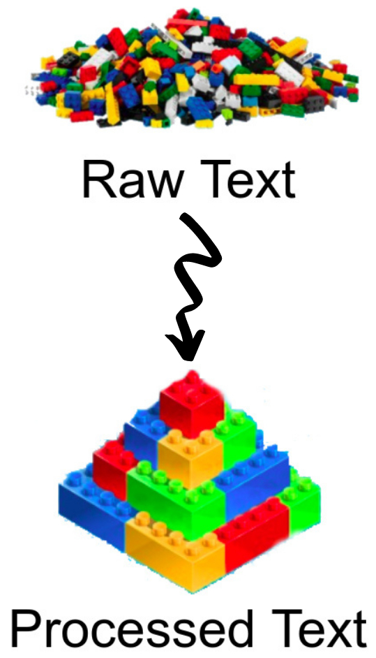
Need To Preprocess Text Data
Convert data to a form that’s understandable by model.
Remove unnecessary words and noise from the data
Transform anything that may provide some insight but would be removed in typical cleaning.

Slide 9
Removing Noise from Text
01
02
03
Removing Punctuations
Removing Numbers
Removing Hyperlinks
Can be removed using regex.
Can be removed using regex.
Can be removed using lxml. Can be done using regex but not prefered

Slide 10




Domain Specific Pre-Processing
Emojis convey a meaning hence it’s better to not remove them.
Using emoji library you can convert emoji to text.
Often on social media the text you write isn’t grammar friendly.
Using PyEnchant we can correct the spellings.
Demojize
Spell Correction
May or may not improve the results hence you can try with both and use the most suited approach.
Using regex you can remove the hashtags.
Scraped data in raw form or any other data depend on method extracted may contain html tags.
Can be removed using lxml. Can be done using regex but not prefered
Hashtags
HTML Tags

Slide 11
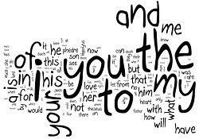
Stopwords
Words which does not add much meaning to a sentence.
They may add structure to the sentence but don’t add any insight about the meaning.
NLTK has a list of stopwords inbuilt for various languages.

Slide 12
Stemming vs Lemmatization
Stemming
Lemmatization
Stemming converts words to it’s root form. Helps reducing the dimensions and making data more dense.
The stemmed words may or may not be a part of the english vocabulary.
PorterStemmer is a popular stemmer and available in NLTK.
Lemmatization, like stemming, converts words to it’s root form.
Lemmatized words are a part of the english vocabulary.
WordnetLemmatizer is available in NLTK.

Slide 13
Why Stem anyway?
Advantages
01
Makes dataset more dense by reducing dimension by 2-3 folds.
02
Downside?
Sometimes adding inflections may add a difference which will be removed in stemming.

Slide 14
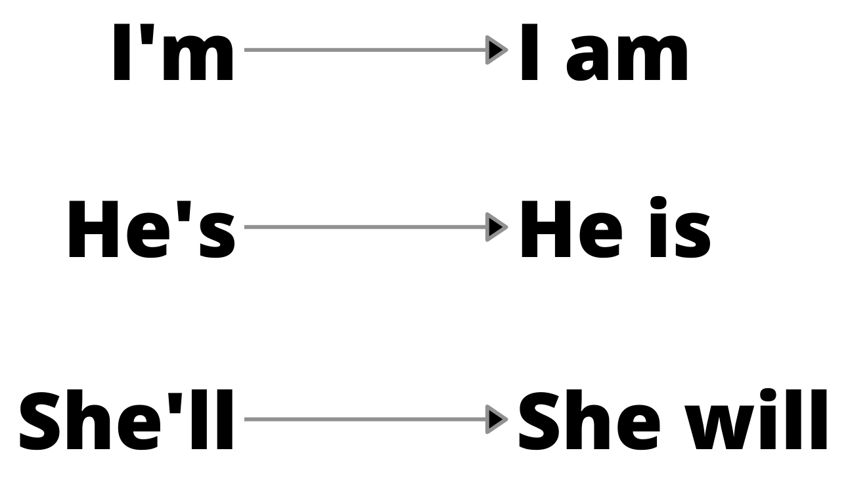
Contractions - To be or not to be?
Contractions are abbreviation for a sequence of words.
You can expand contractions but most expanded ones will be removed when you remove stopwords.
Hence it may not matter much.

Slide 15
Text Pre-Processing Pipeline
Removing Noise
Transform any abnormalities
Lowercase and split
Numbers
Punctuations
Hyperlinks
Spell Correction
Demojization
Remove HTML Tags
Process HashTags
Convert Text to lowercase.
Convert the text into list of words.

Slide 16
Text Pre-Processing Pipeline
Remove Stopwords
Stem the words
Join and Return
Remove stopwords from the list of words
Apply stemming or lemmatization on the words given
Join the list of words into text again.
Return the joined text.

Slide 17
Frequency Based Embedding

Slide 18
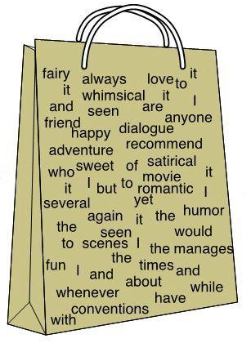

Count Vectorizer
Convert a sentence to a Bag of Word Representation.
Available in sklearn.
Each entry represents frequency of various words in that sentence.

Slide 19
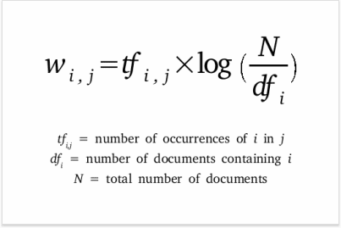
TF-IDF Vectorizer
Convert a sentence to a Vector.
Available in sklearn.
Each entry represents tf-idf of a word.
Measures the uniqueness and relevance of your word.

Slide 20
How it Works?
A Visual Guide

Slide 21
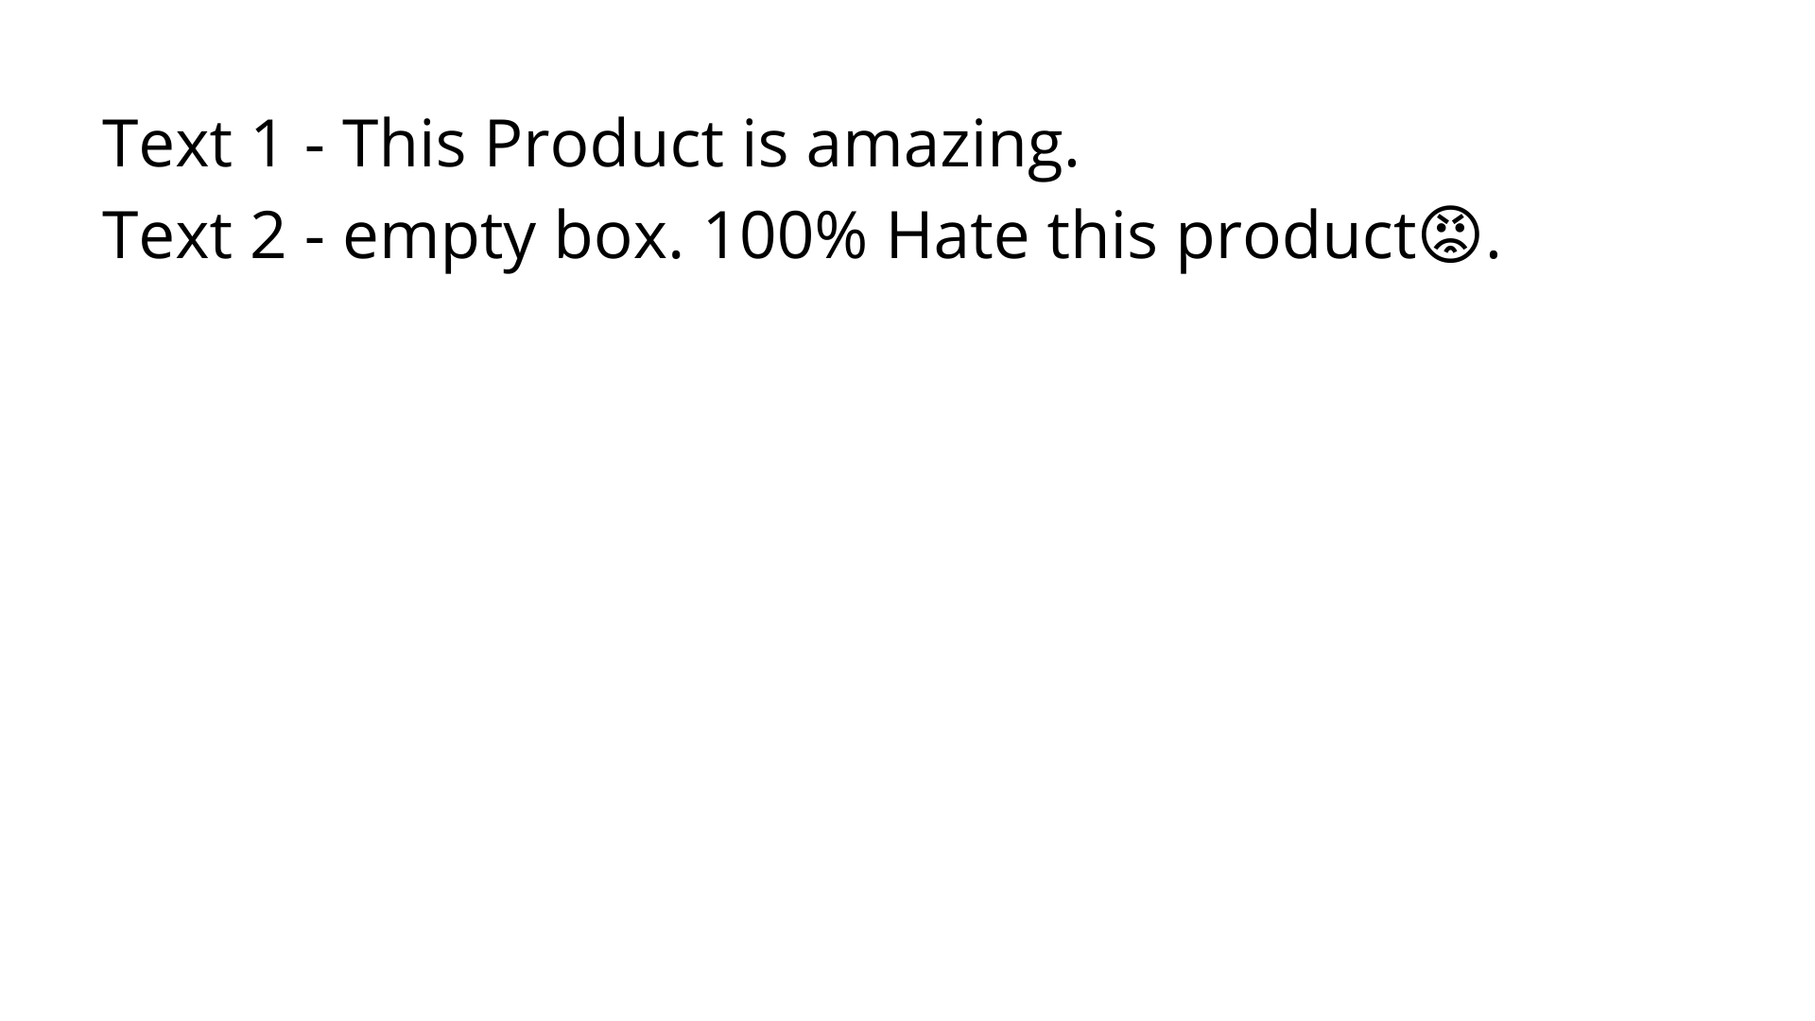

Slide 22
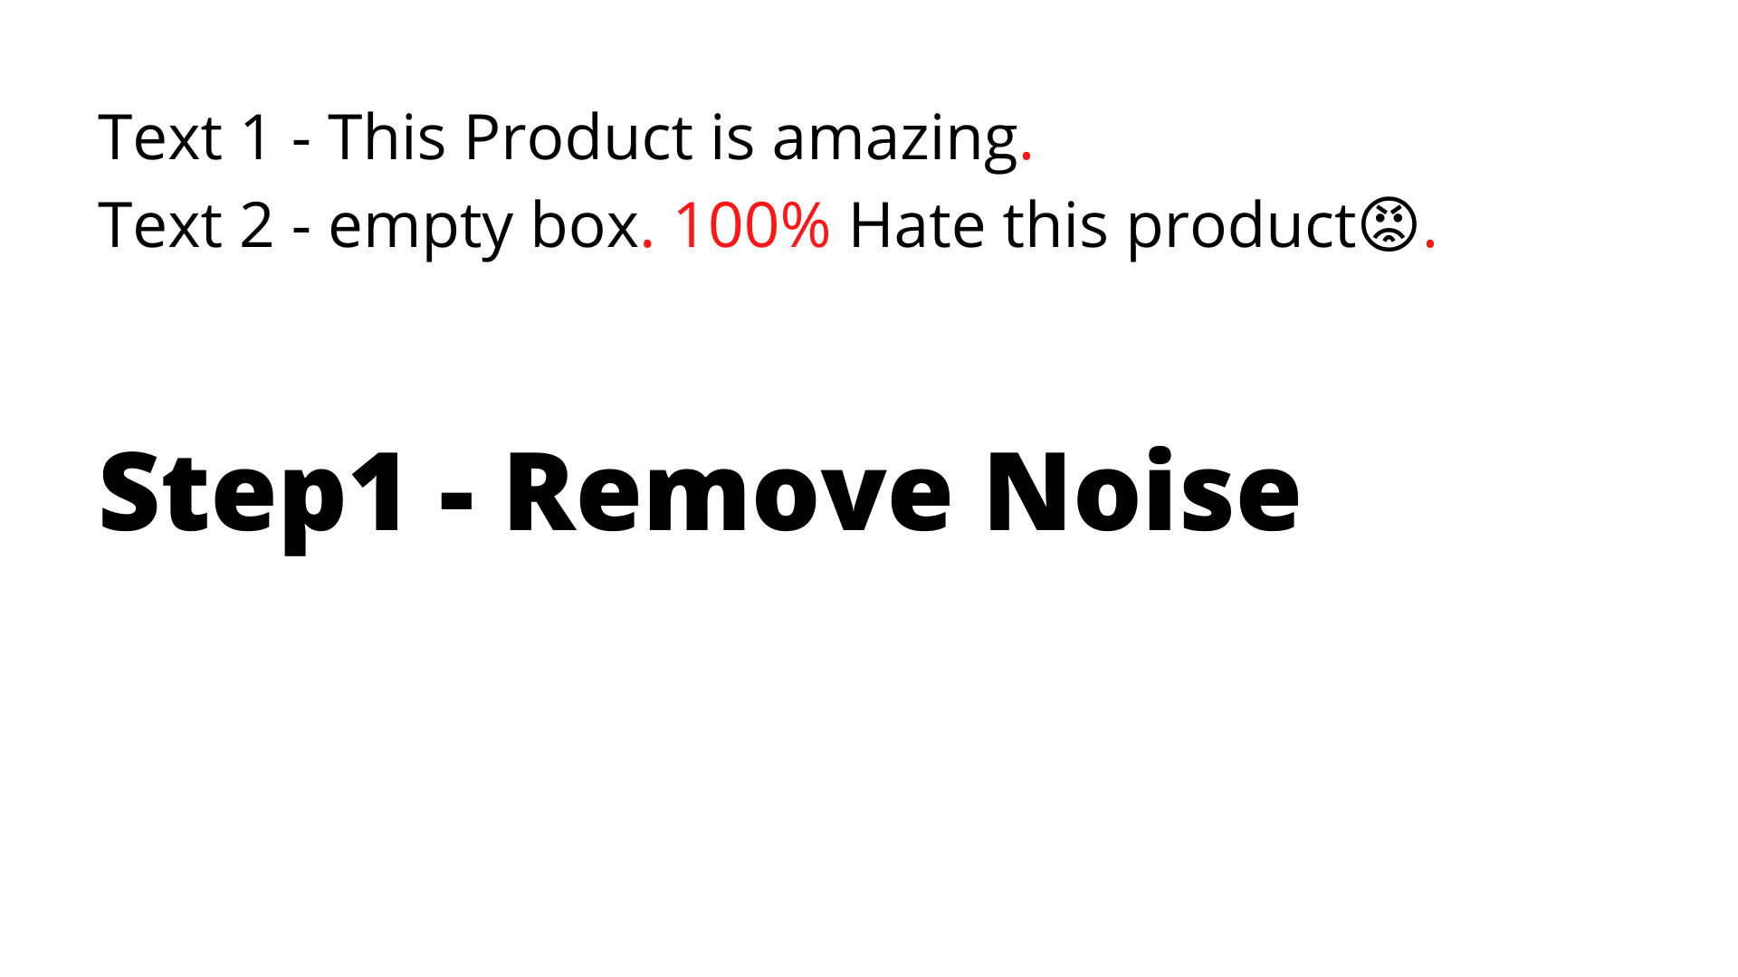

Slide 23
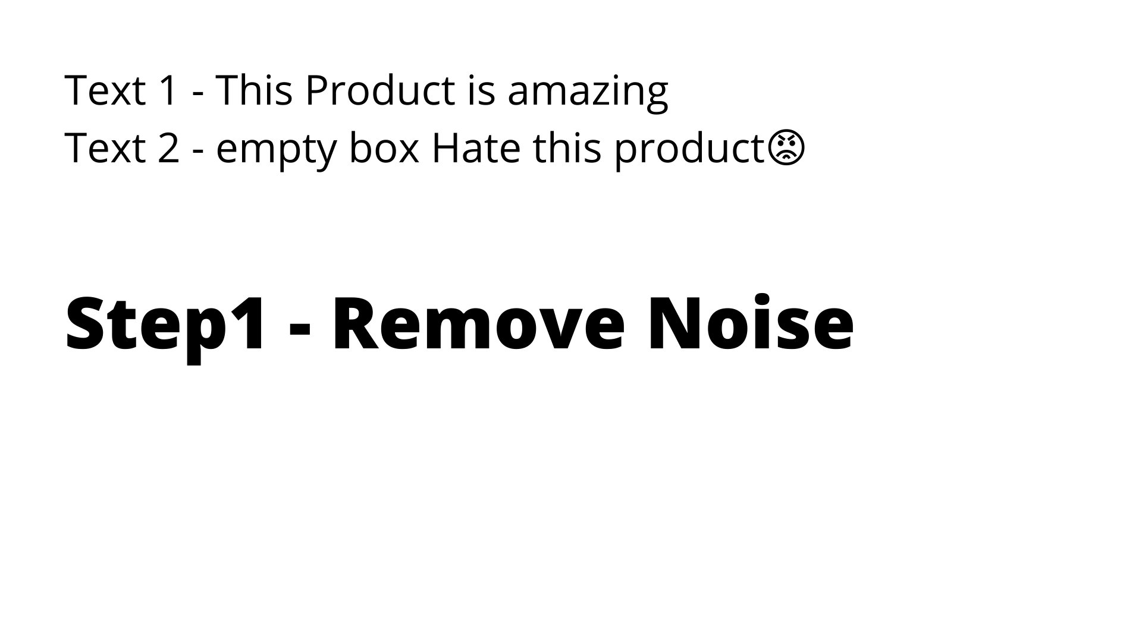

Slide 24
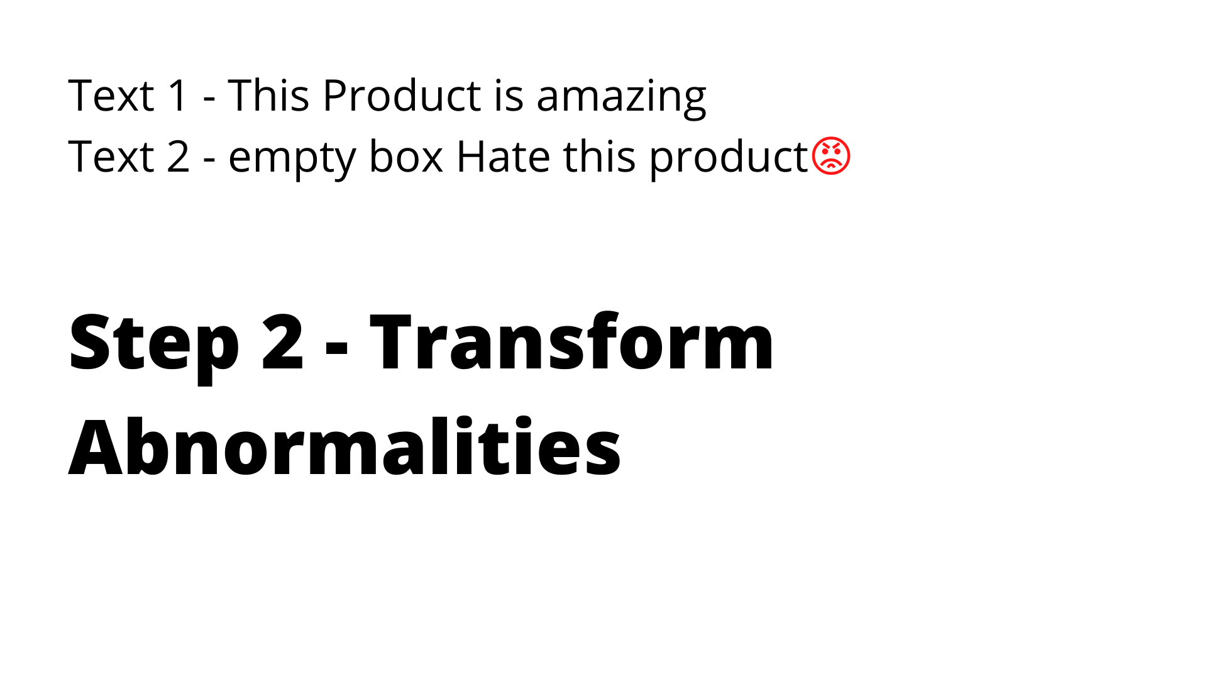

Slide 25
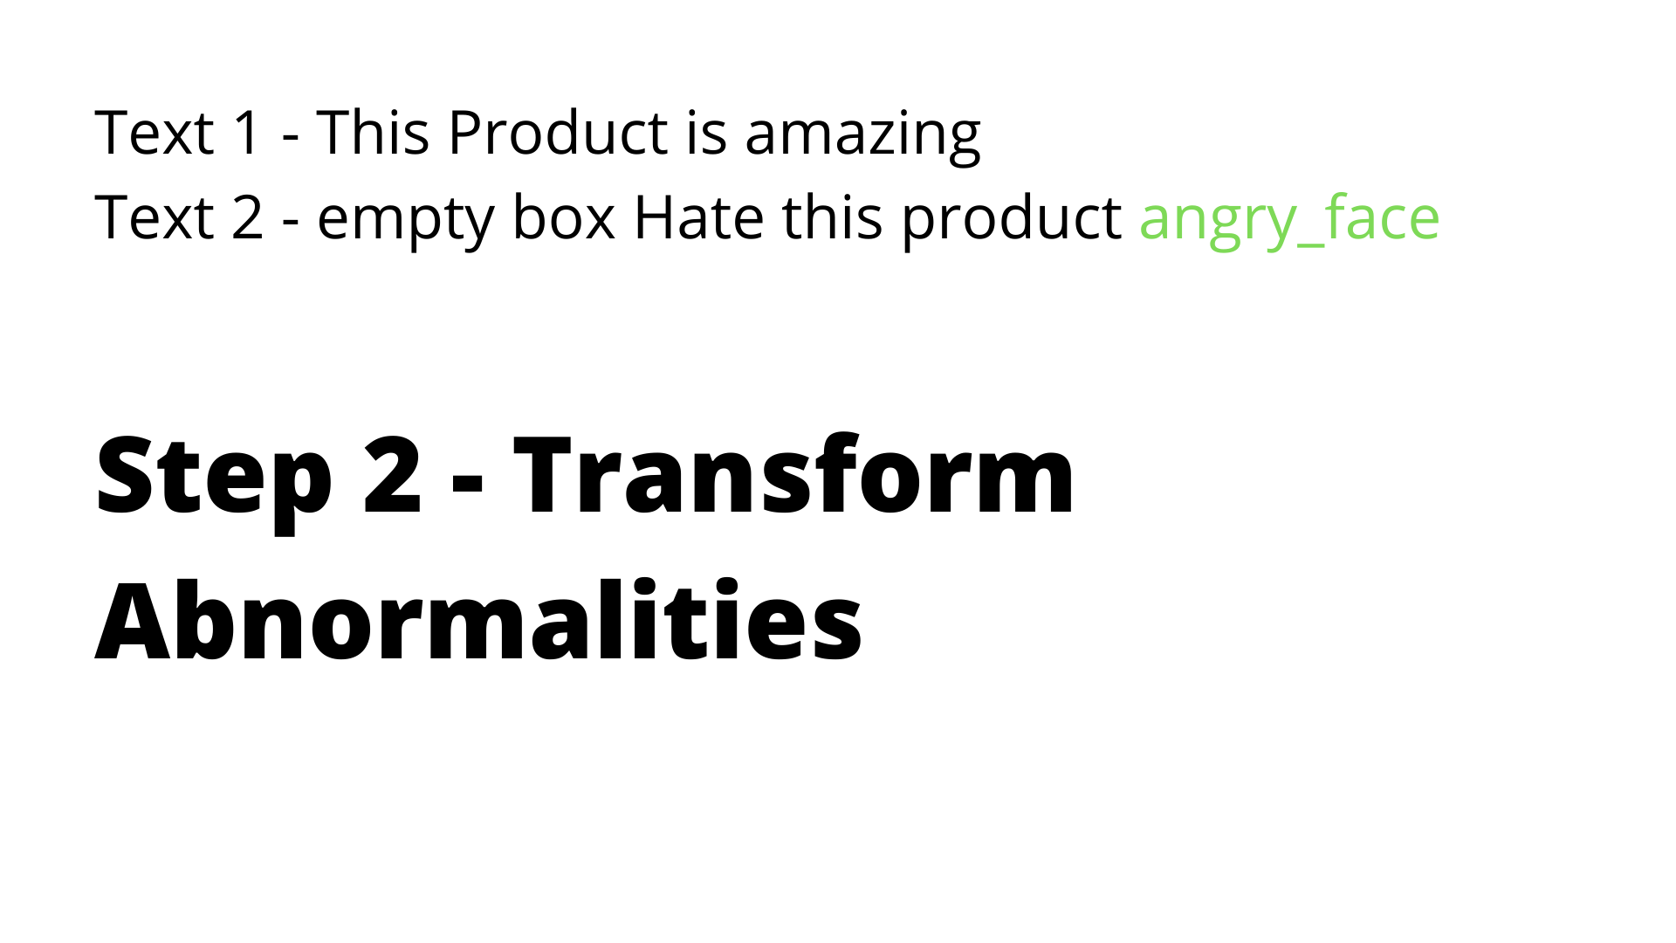

Slide 26
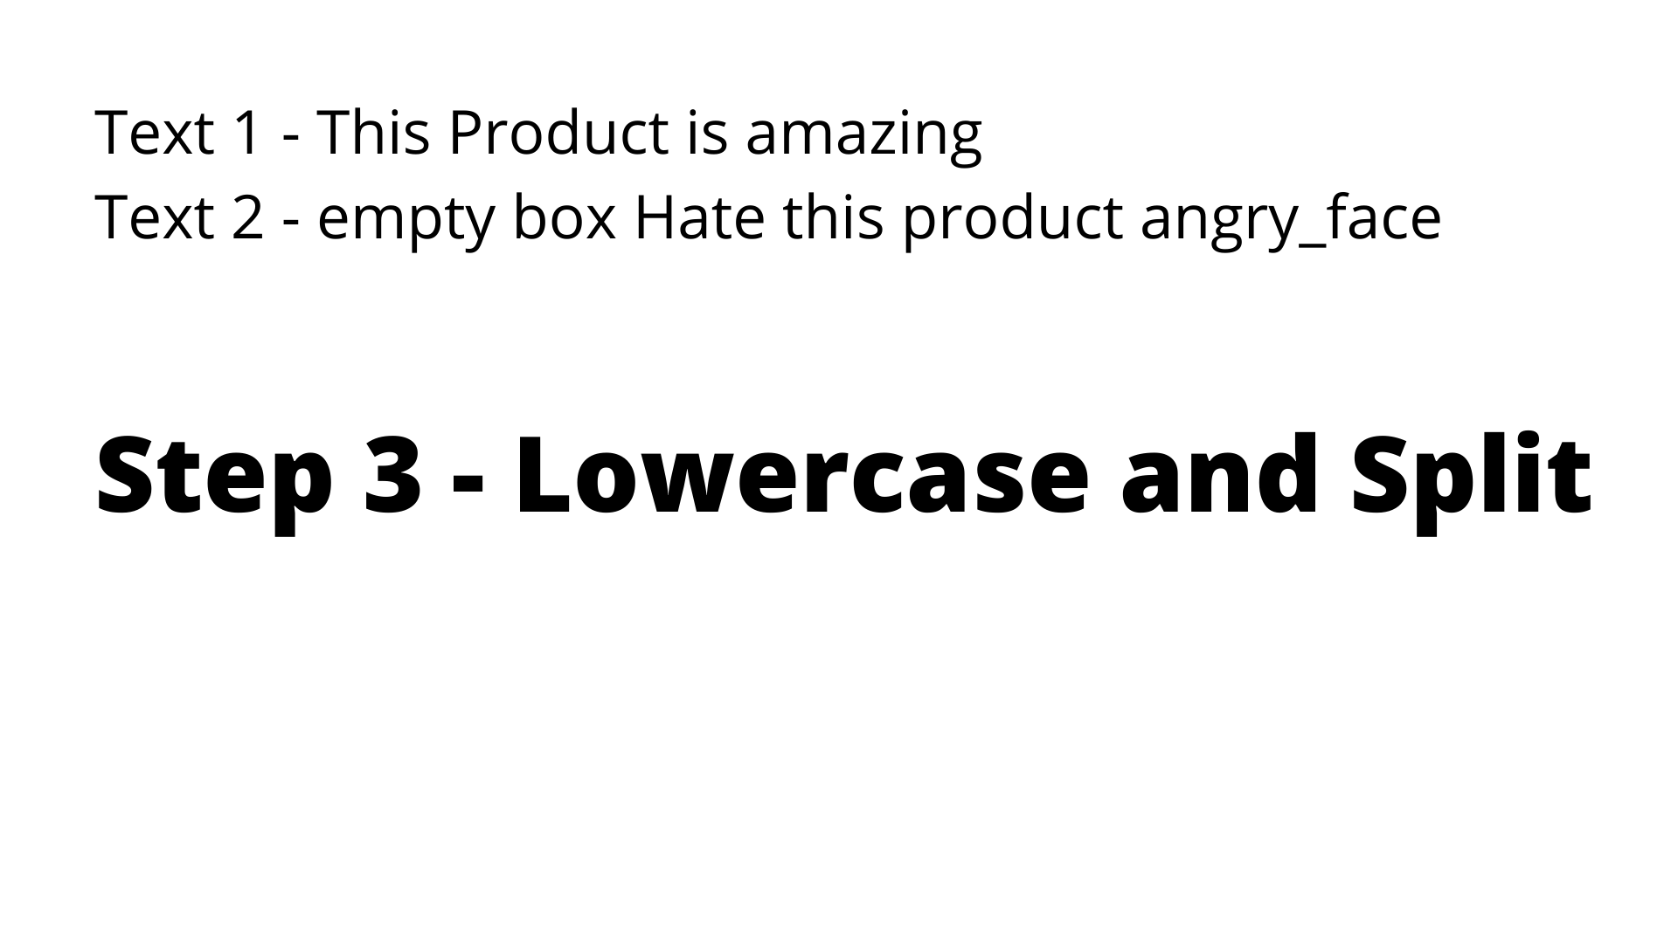

Slide 27
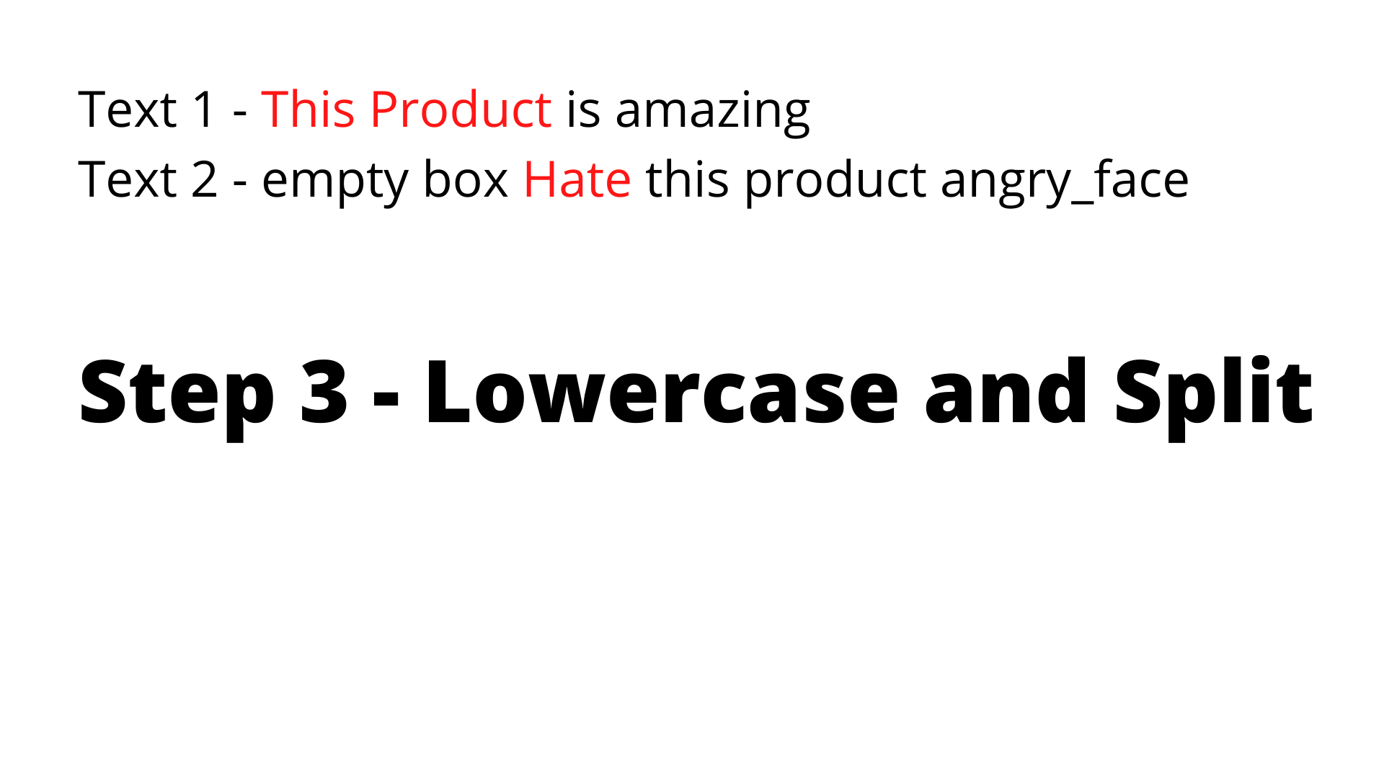

Slide 28
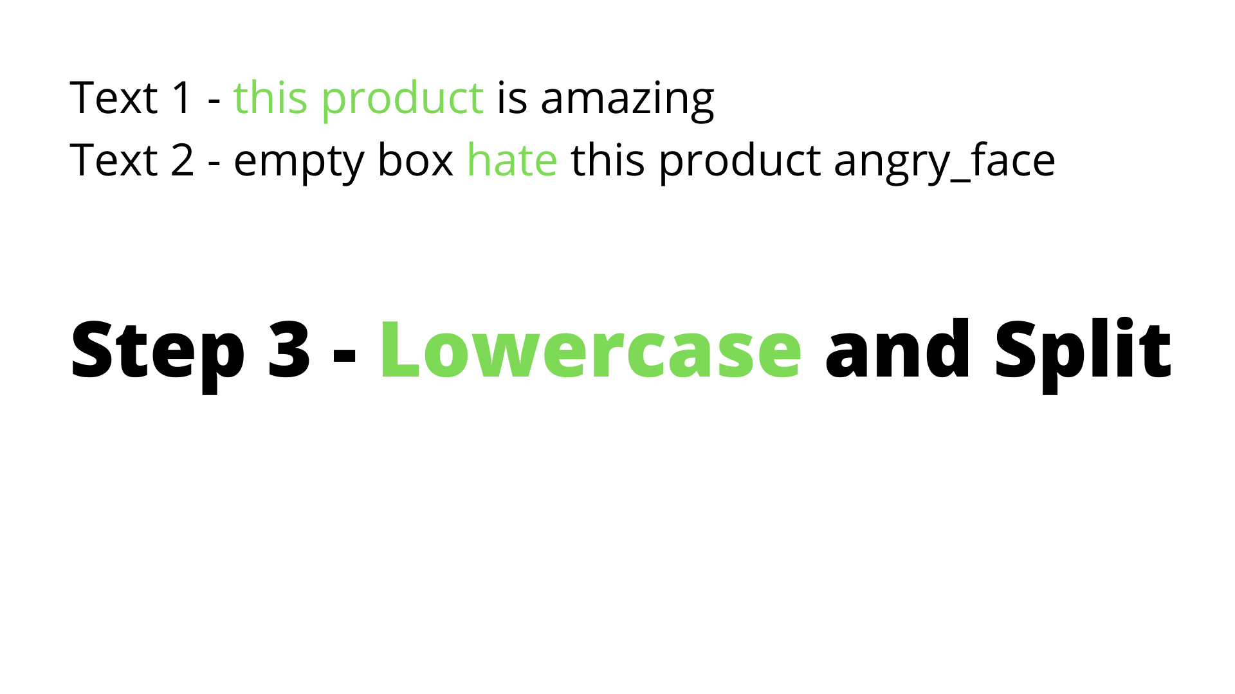

Slide 29
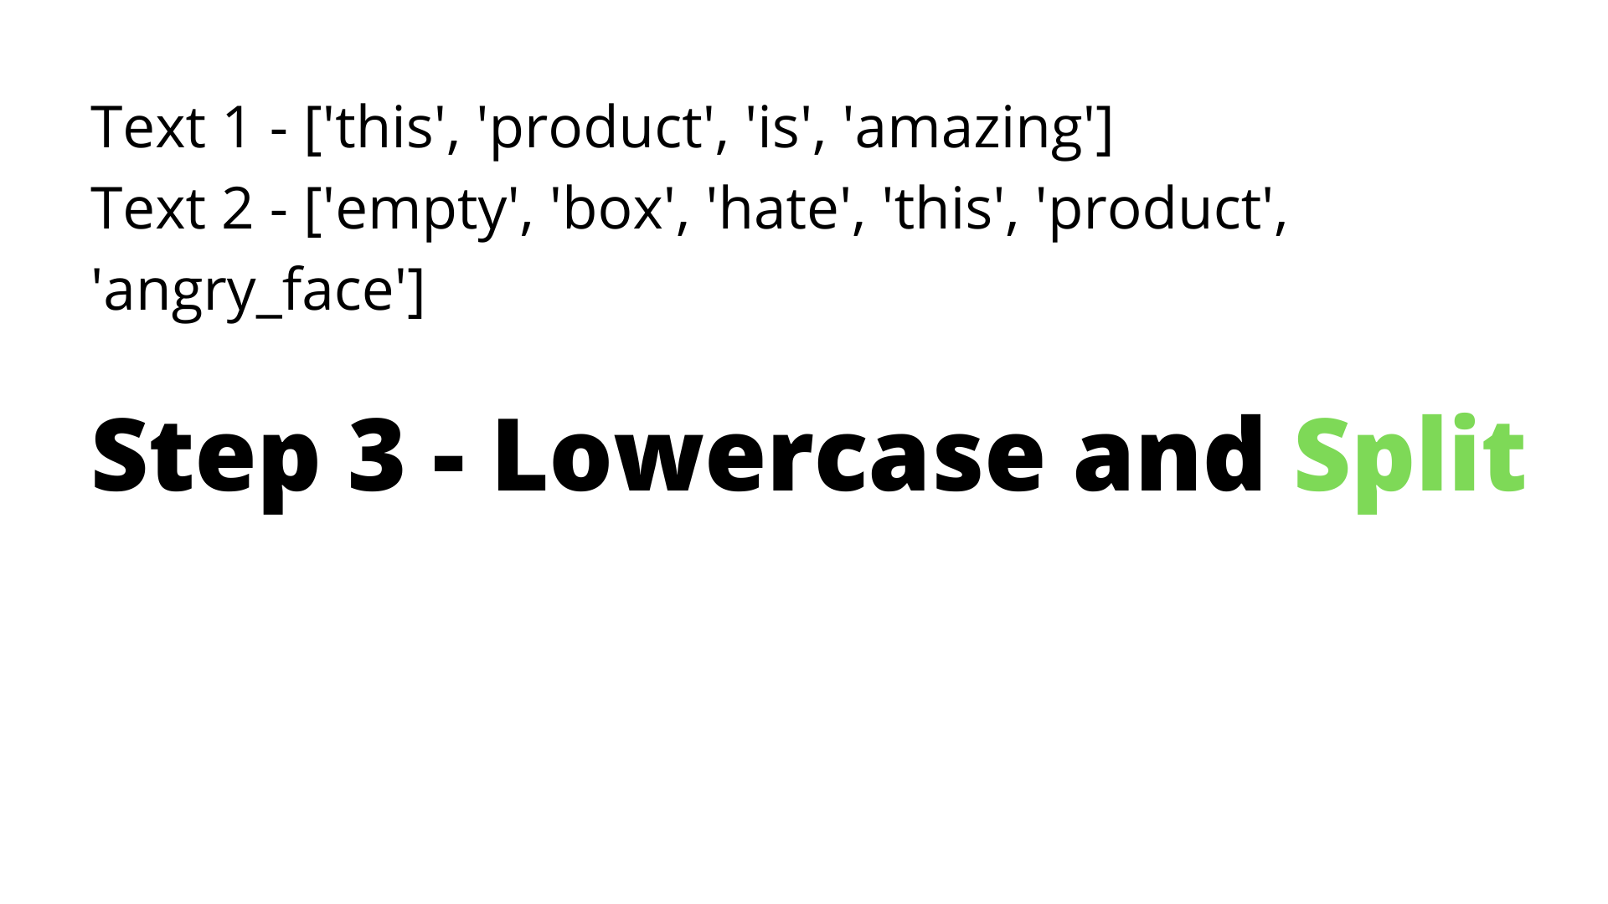

Slide 30
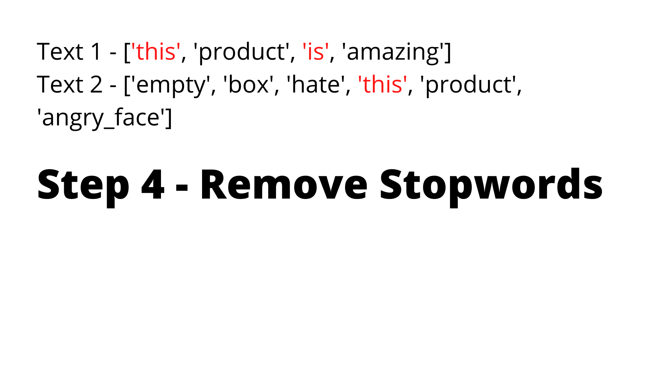

Slide 31
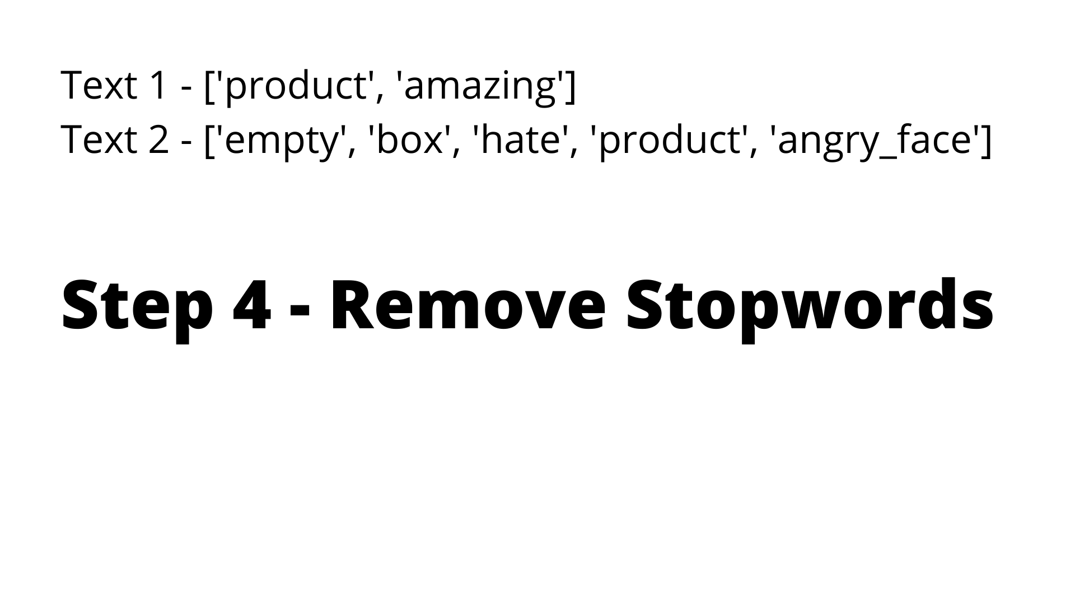

Slide 32
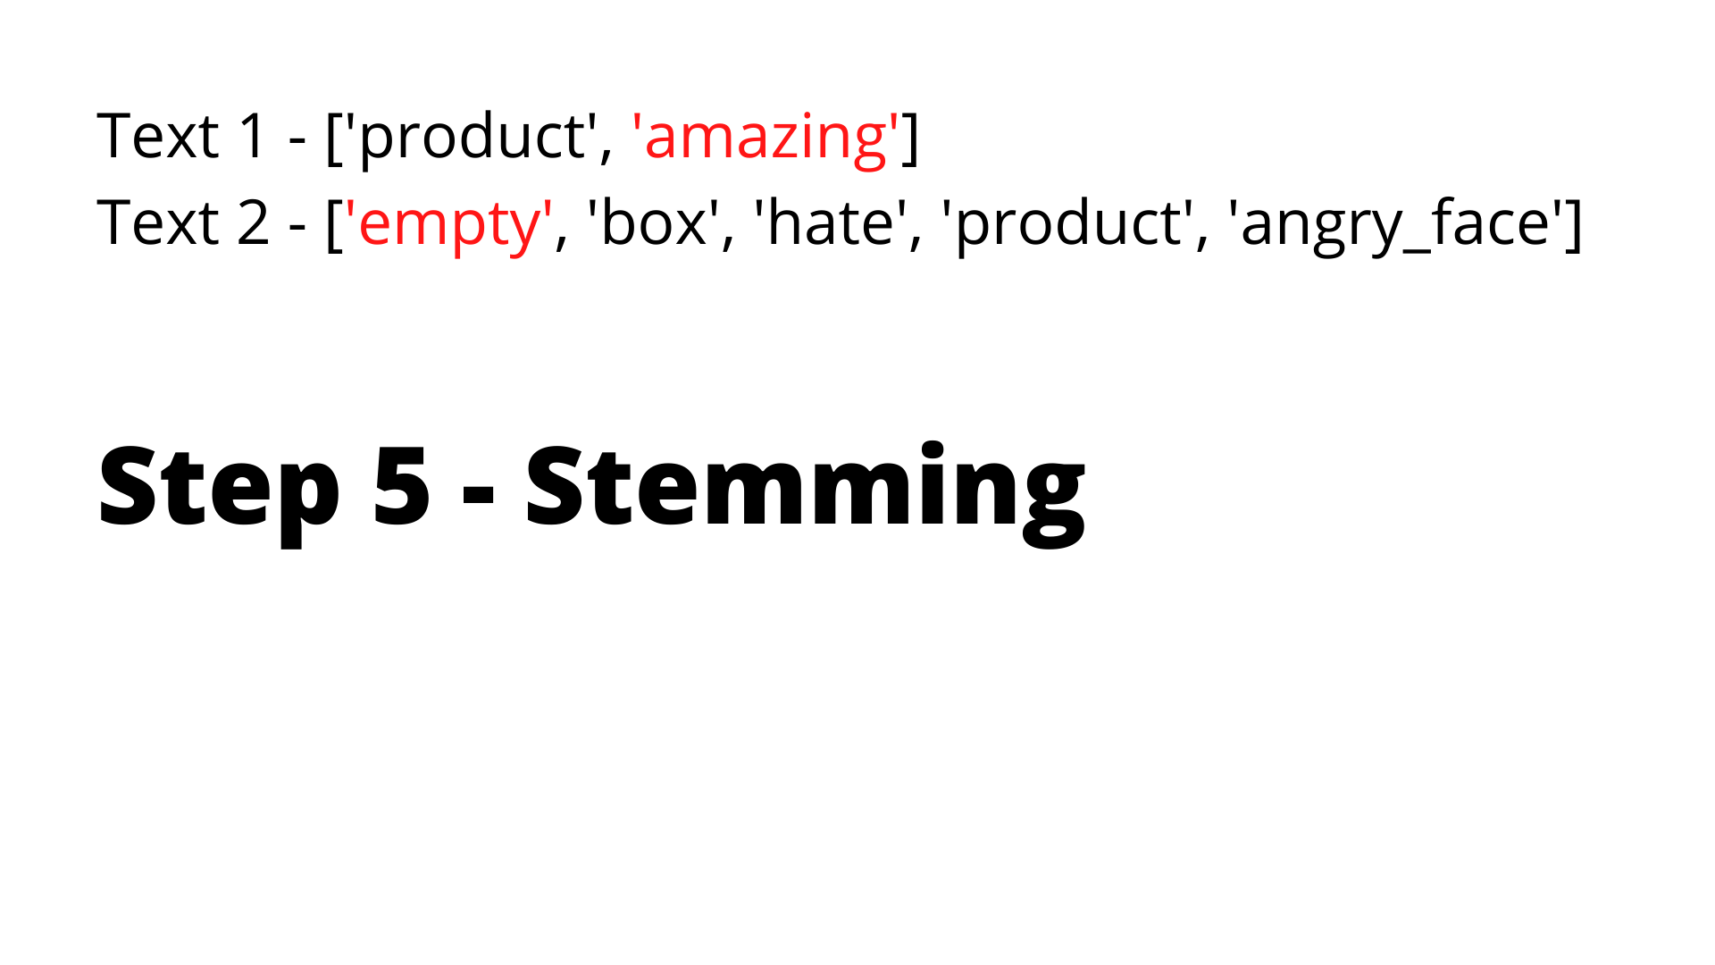

Slide 33
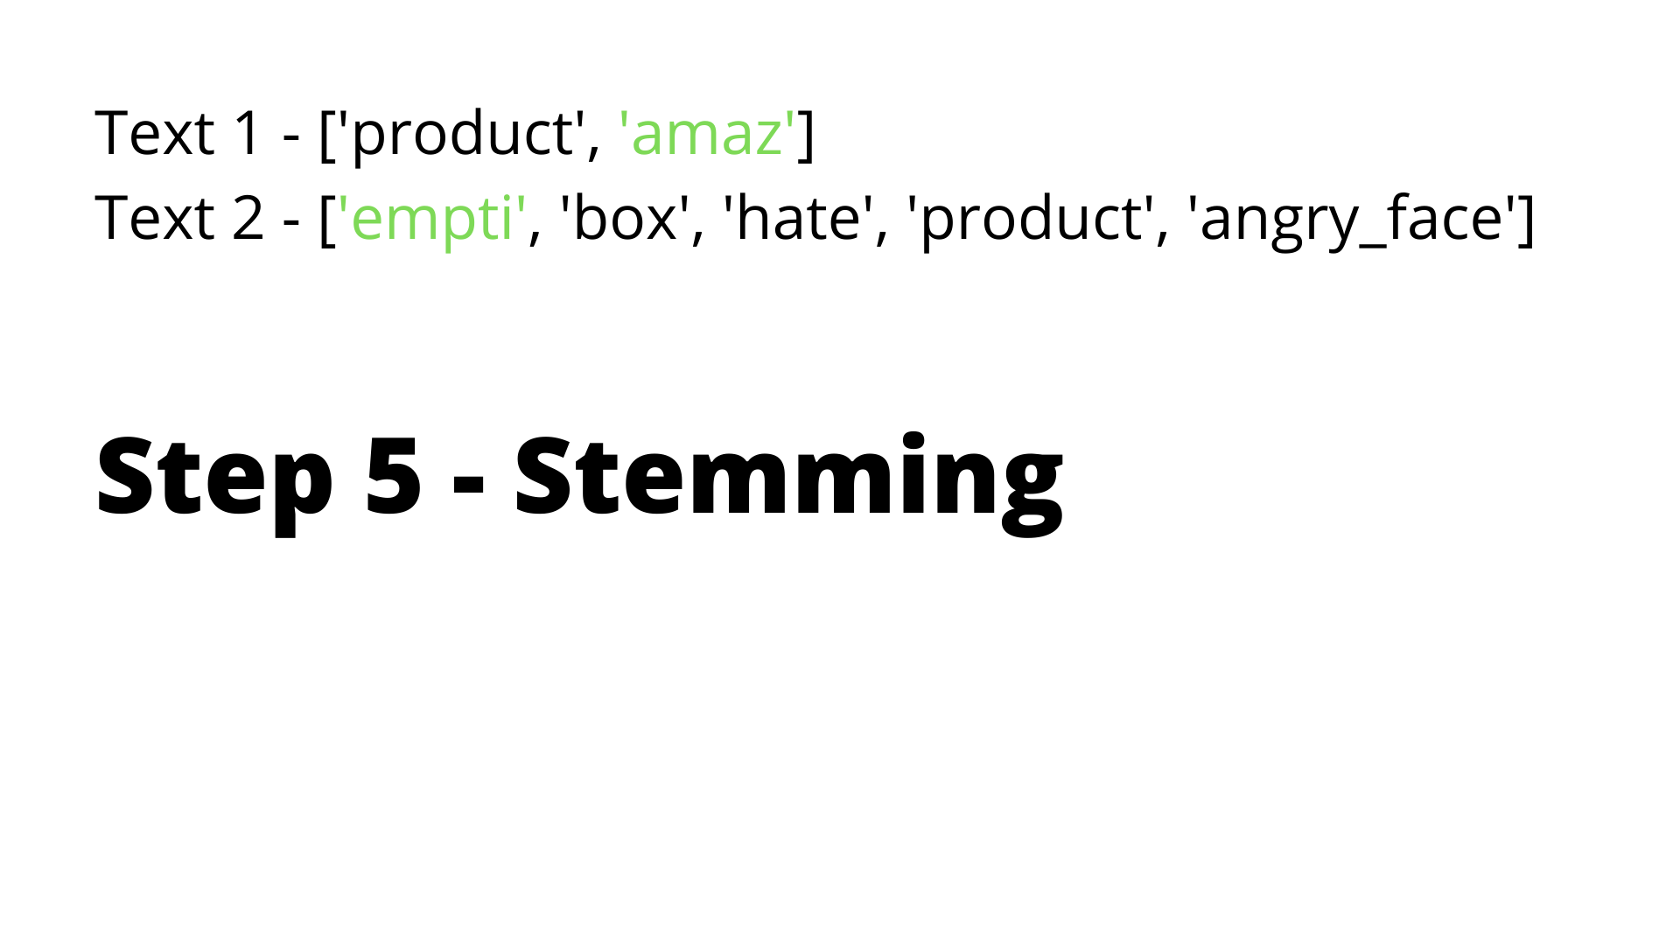

Slide 34
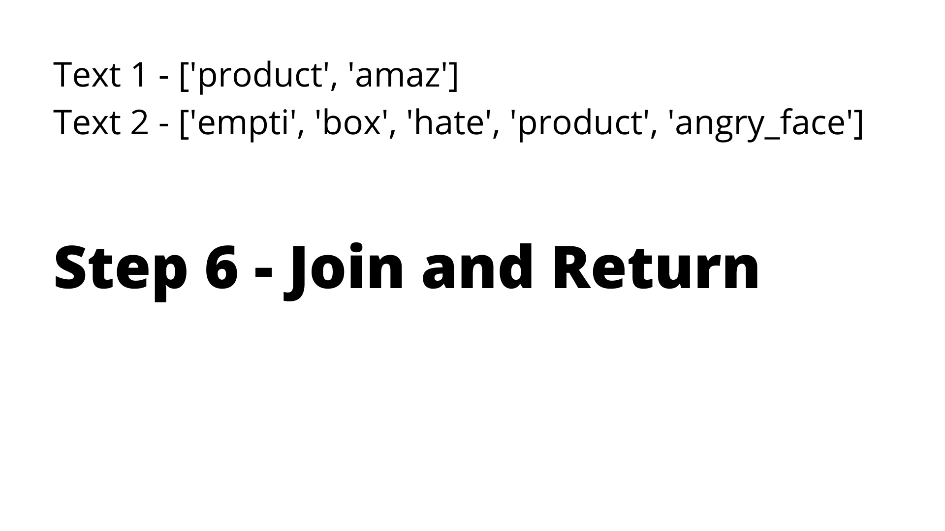

Slide 35
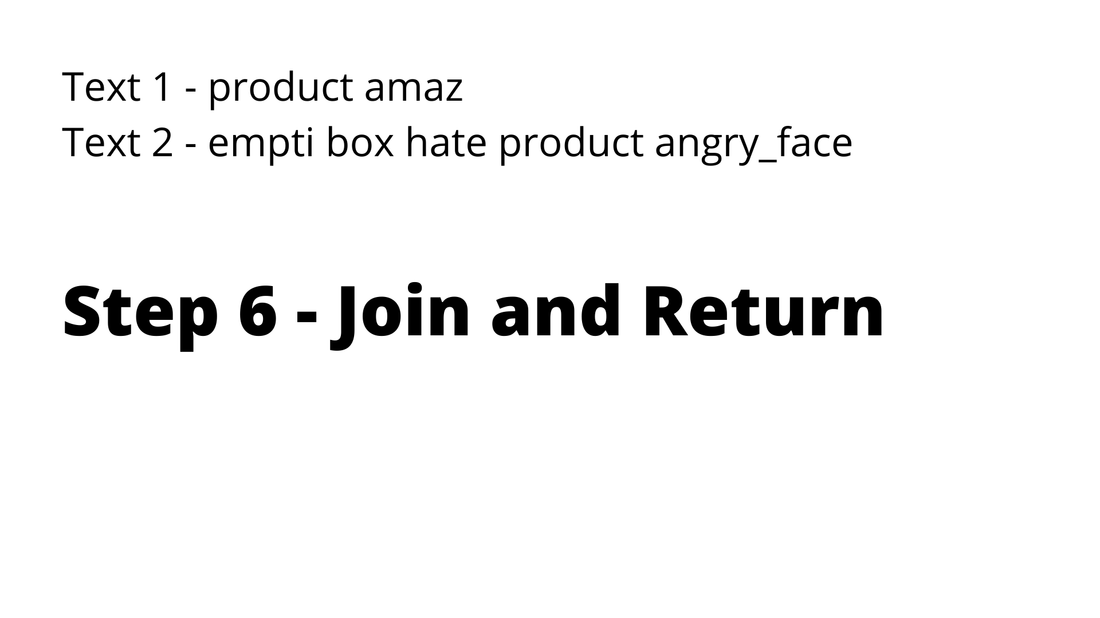

Slide 36
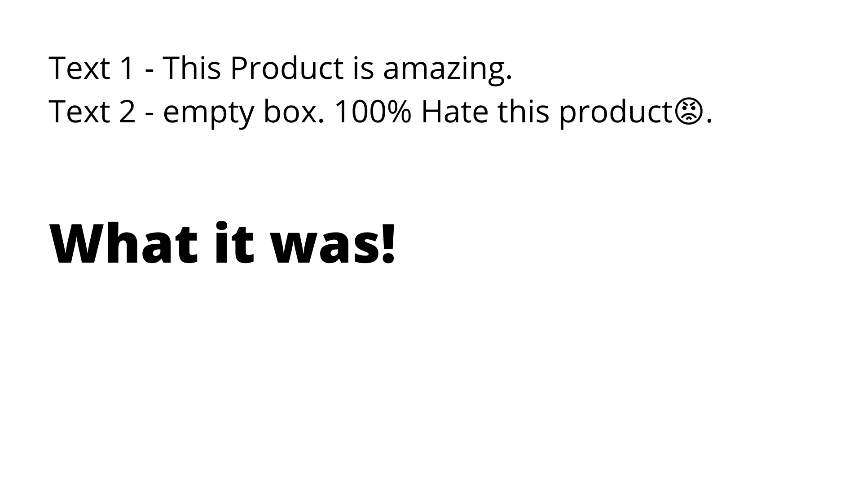

Slide 37
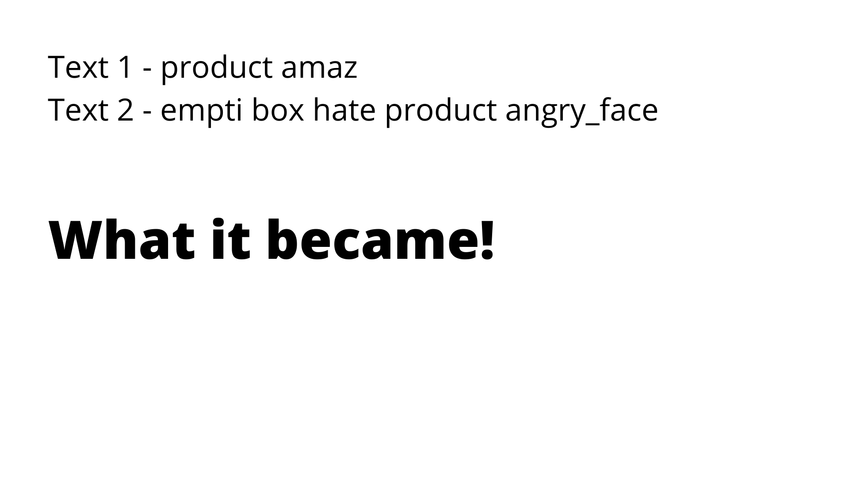

Slide 38
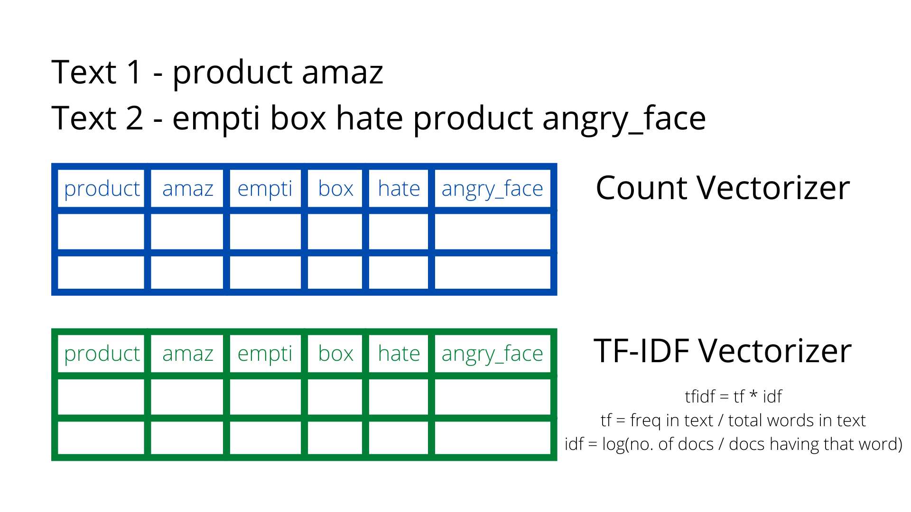

Slide 39
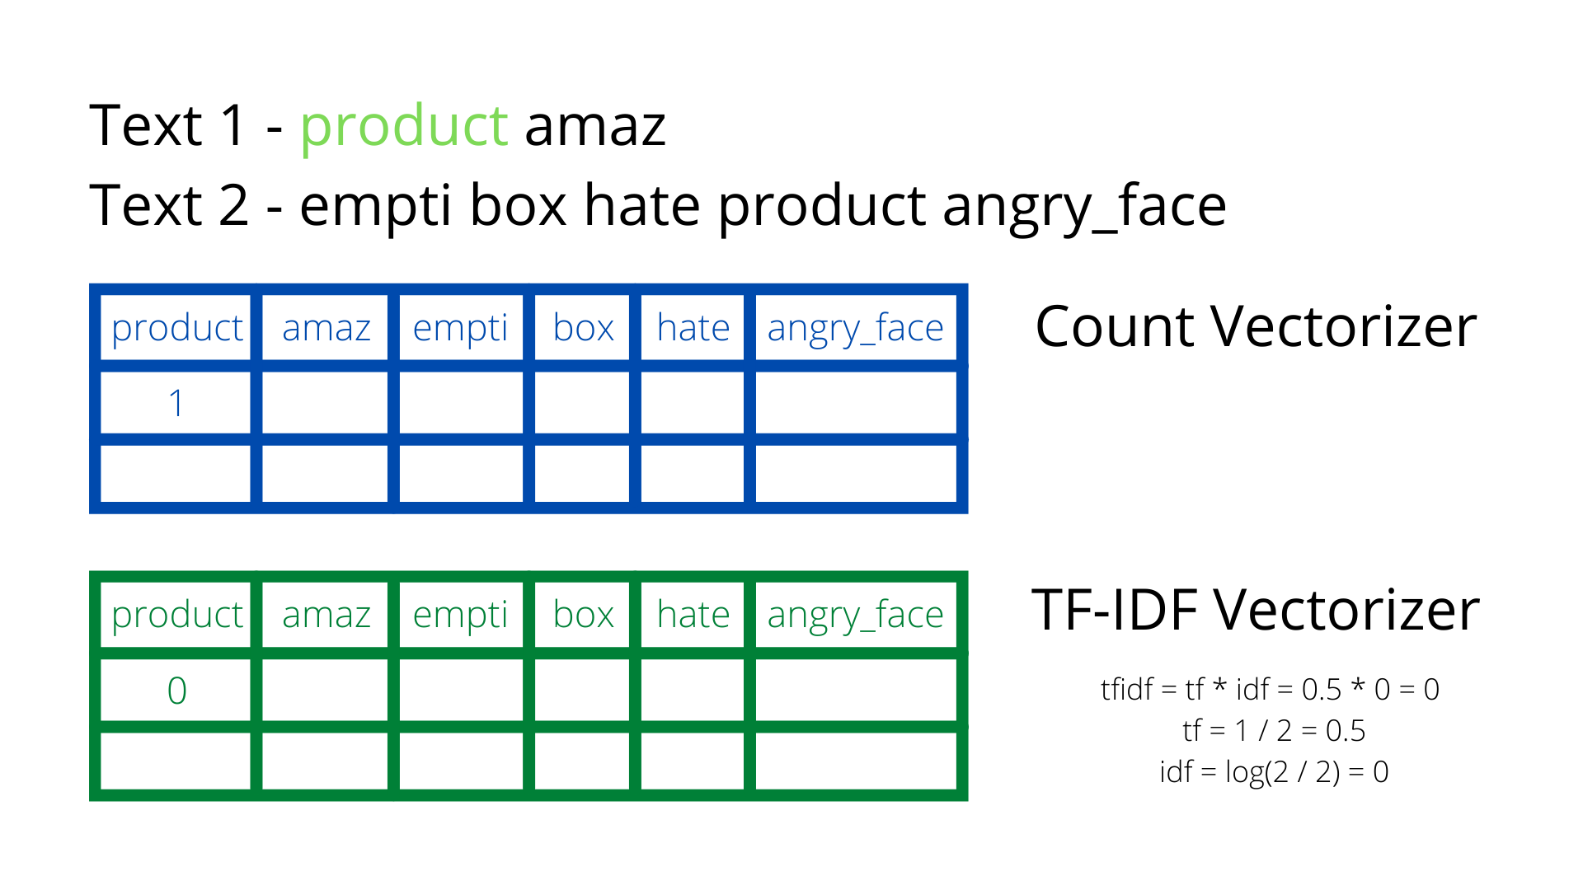

Slide 40
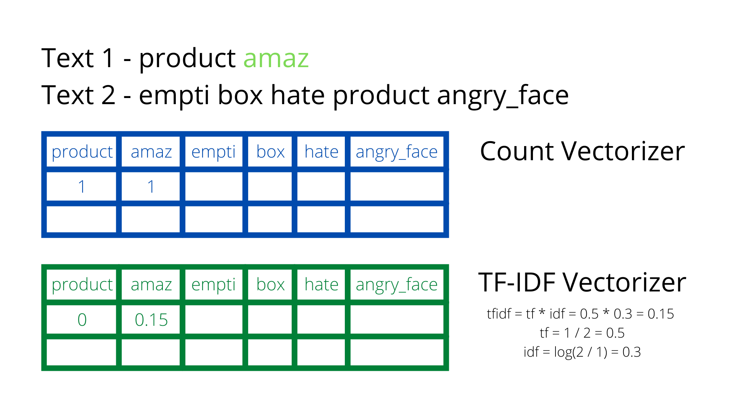

Slide 41


Slide 42
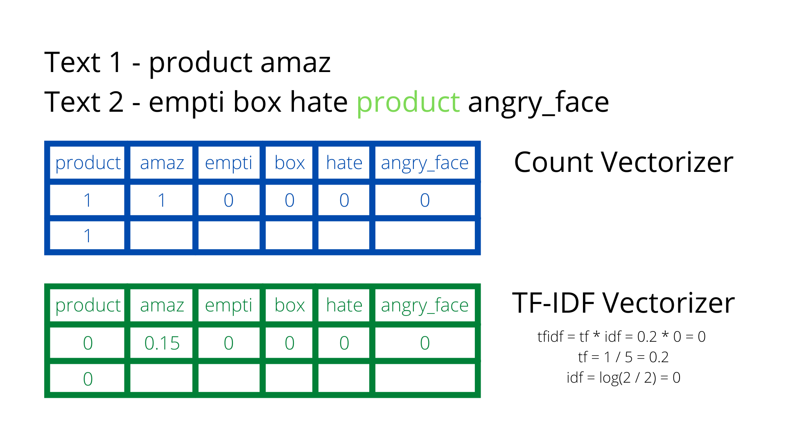

Slide 43
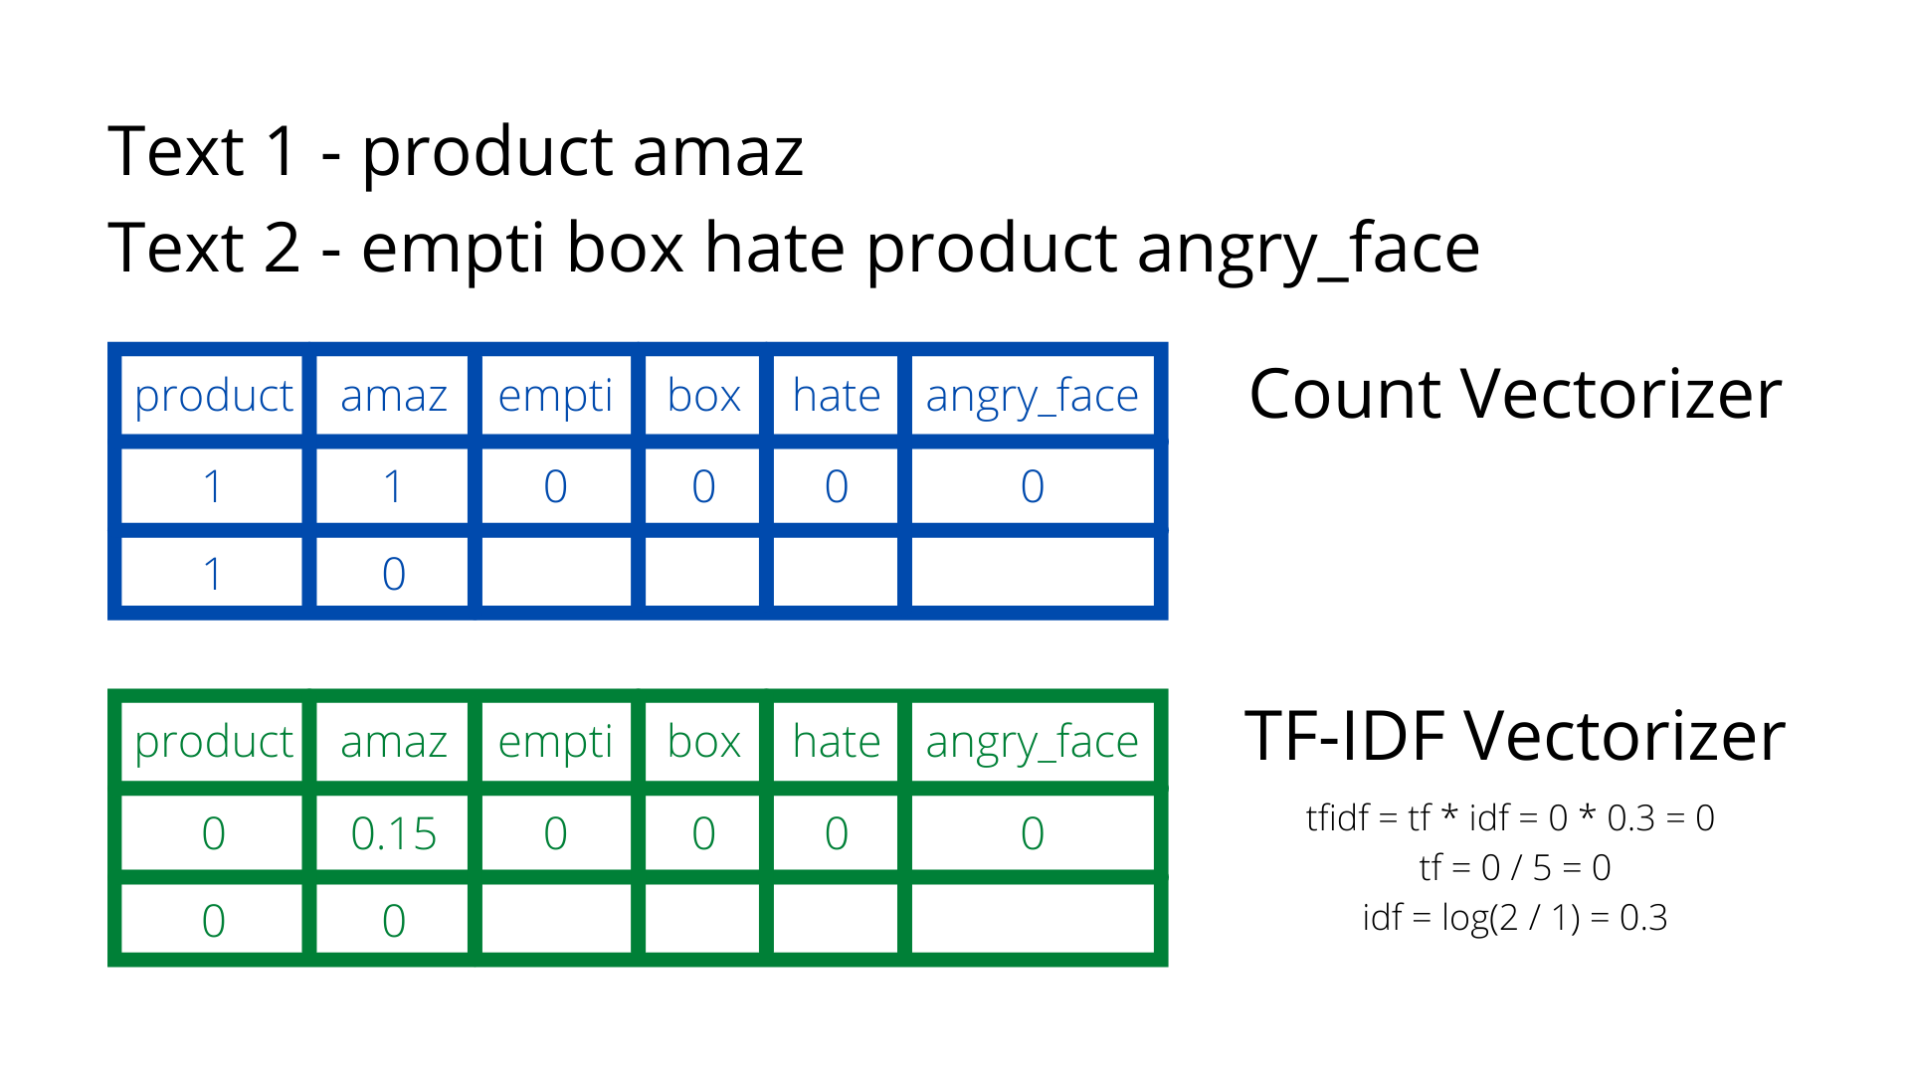

Slide 44
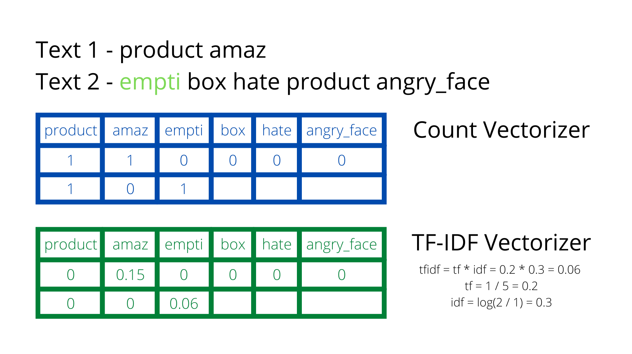

Slide 45


Slide 46
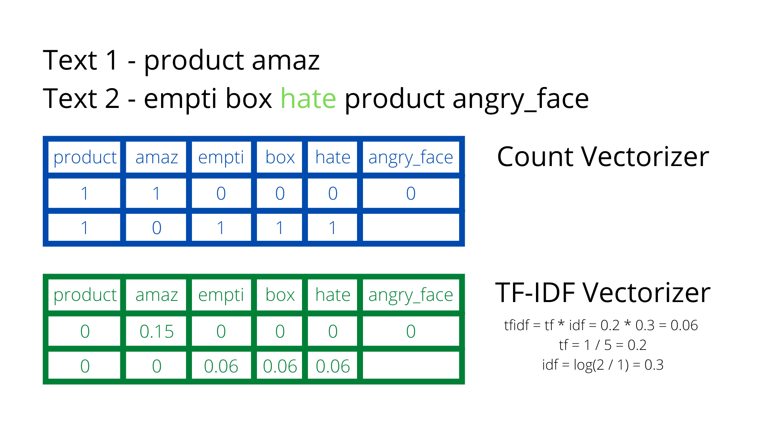

Slide 47
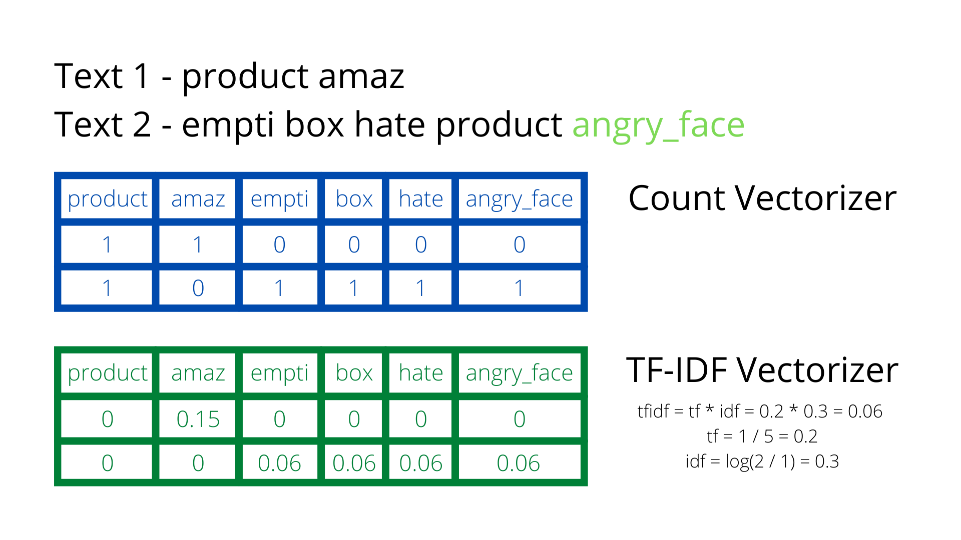

Slide 48
Training Our Model (Demo)

Slide 49
Words as Vectors

Slide 50
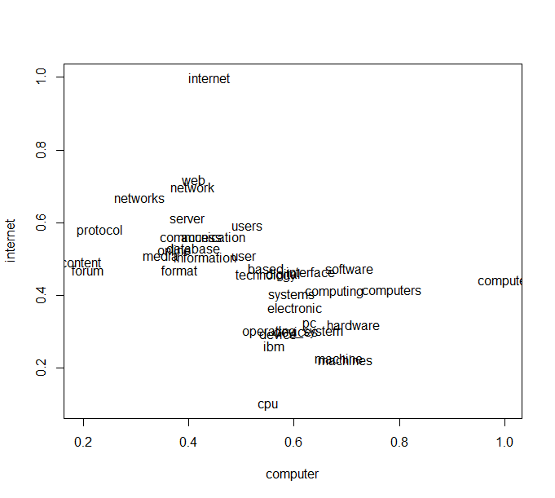
Words as Vectors
What are Vectors?
Object that has both magnitude and direction.
In our case vector is a 1-D grid of numbers.
Measure of similarity can be found using cosine similarity.
What is the goal?
Find hidden relationships between words.
Finding vector representation of words such that 2 words with similar meaning are closer to each other.

Slide 51
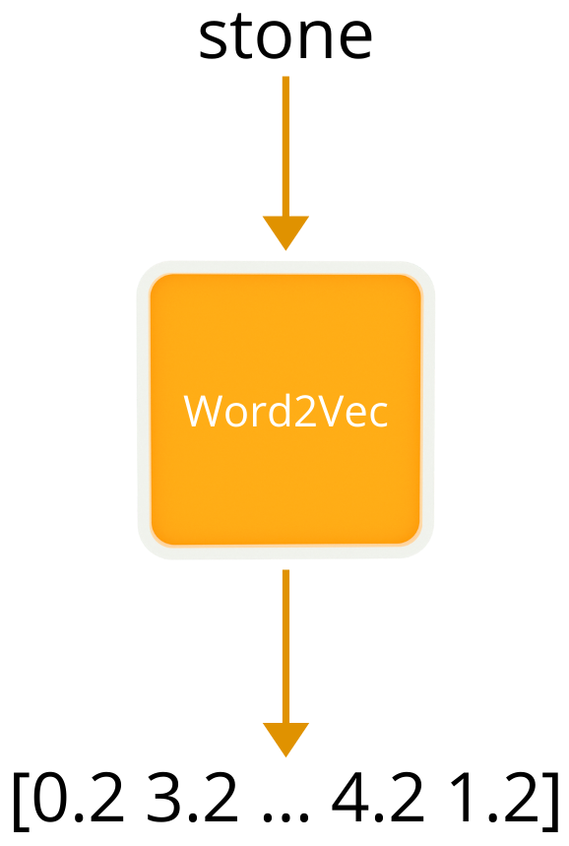
Word2Vec
Trains a shallow neural network taking text as training data.
Resultant vectors are calculated such that words with similar context are nearer.
The length for vector generated is a hyperparameter and can be tweaked.

Slide 52
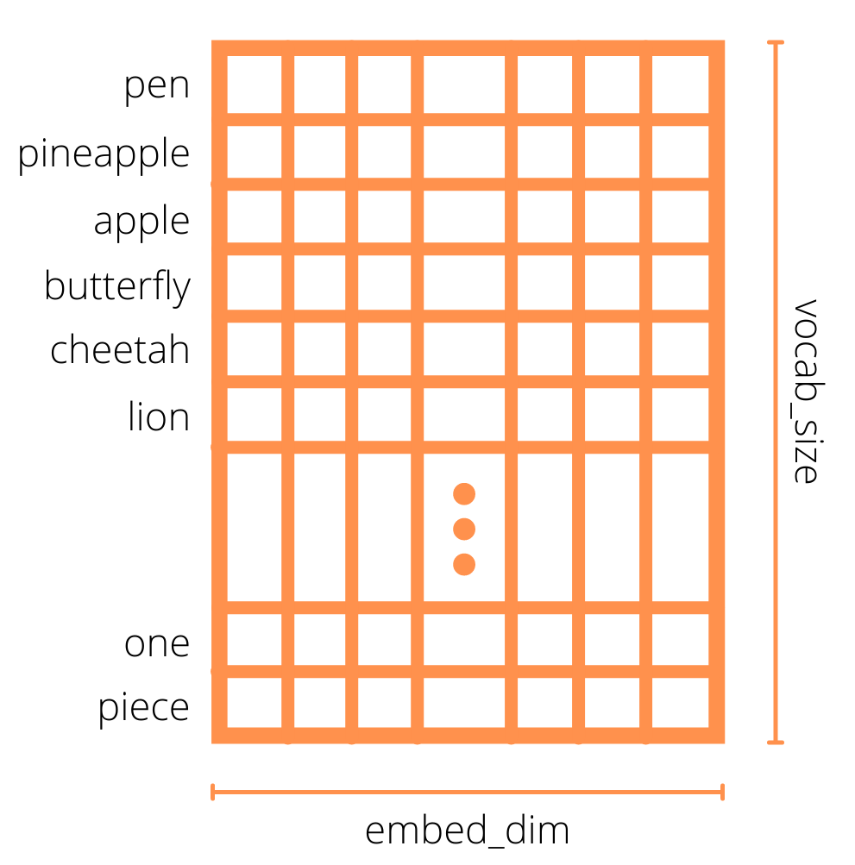
Embedding Layer
A simple lookup table that stores embeddings of a fixed dictionary and size.
In its essence it’s just a Linear Layer. Represent word as one hot encoded vector and pass it to a Linear Layer and you have got your Embedding Layer.
Dataset specific embeddings! Not Generalized.
Can initialize with pretrained weights.

Slide 53
Word2Vec
A Visual Guide

Slide 54
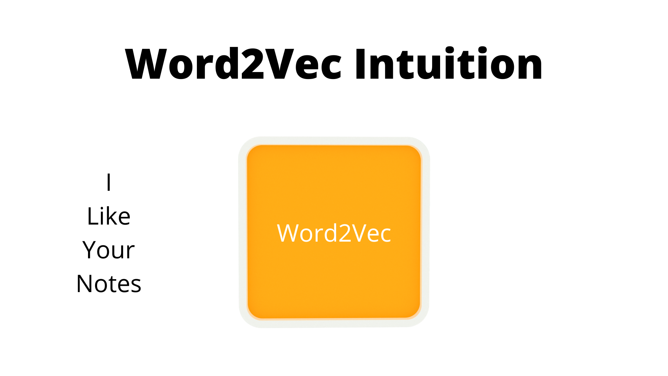

Slide 55
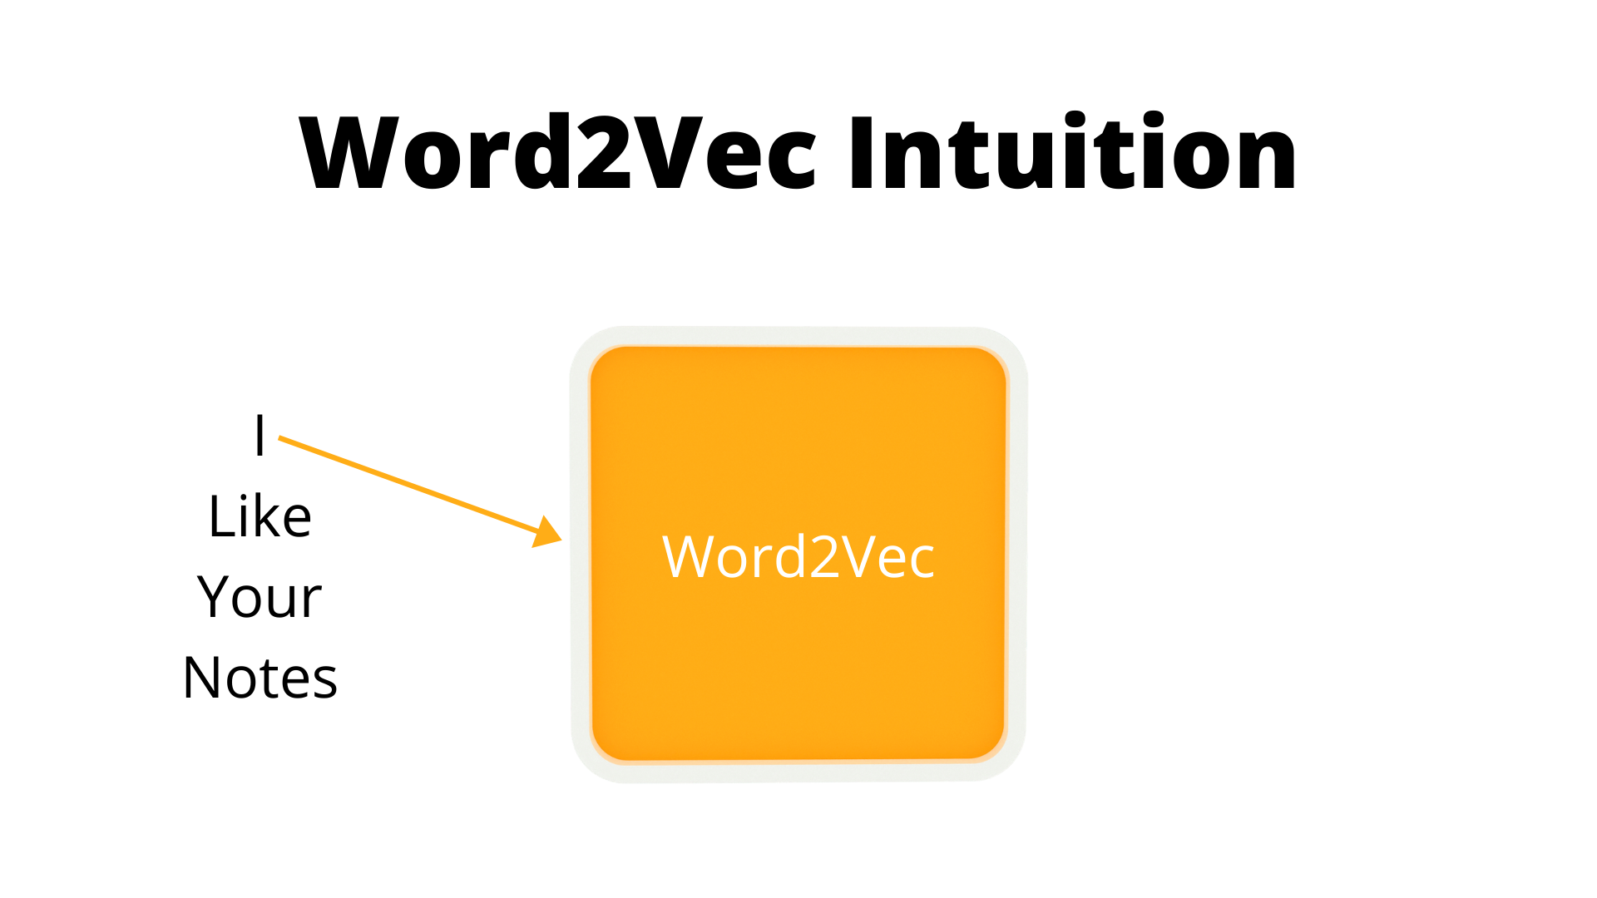

Slide 56
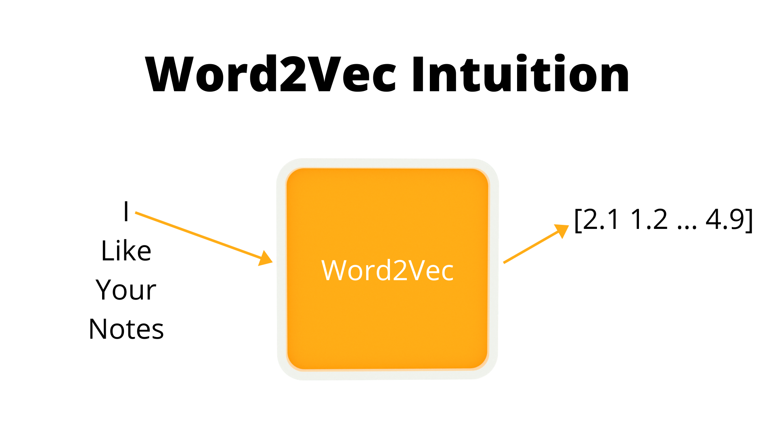

Slide 57
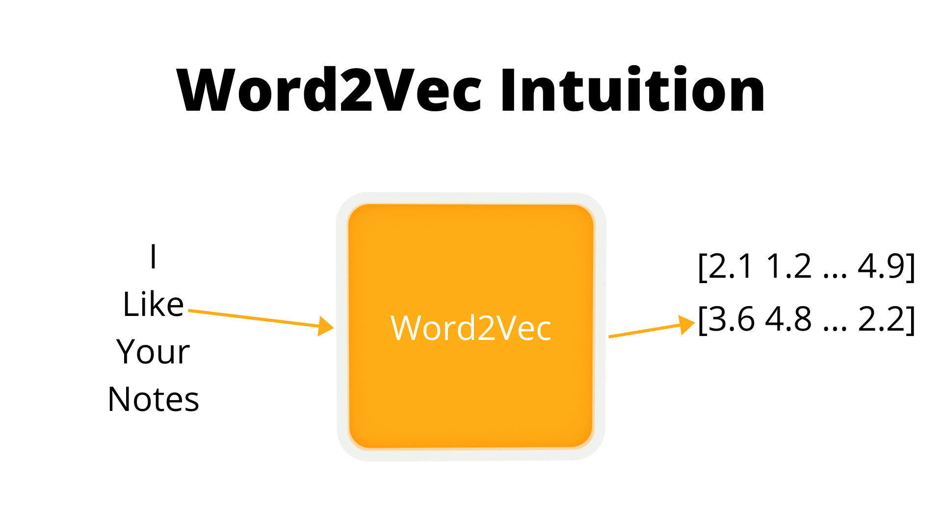

Slide 58
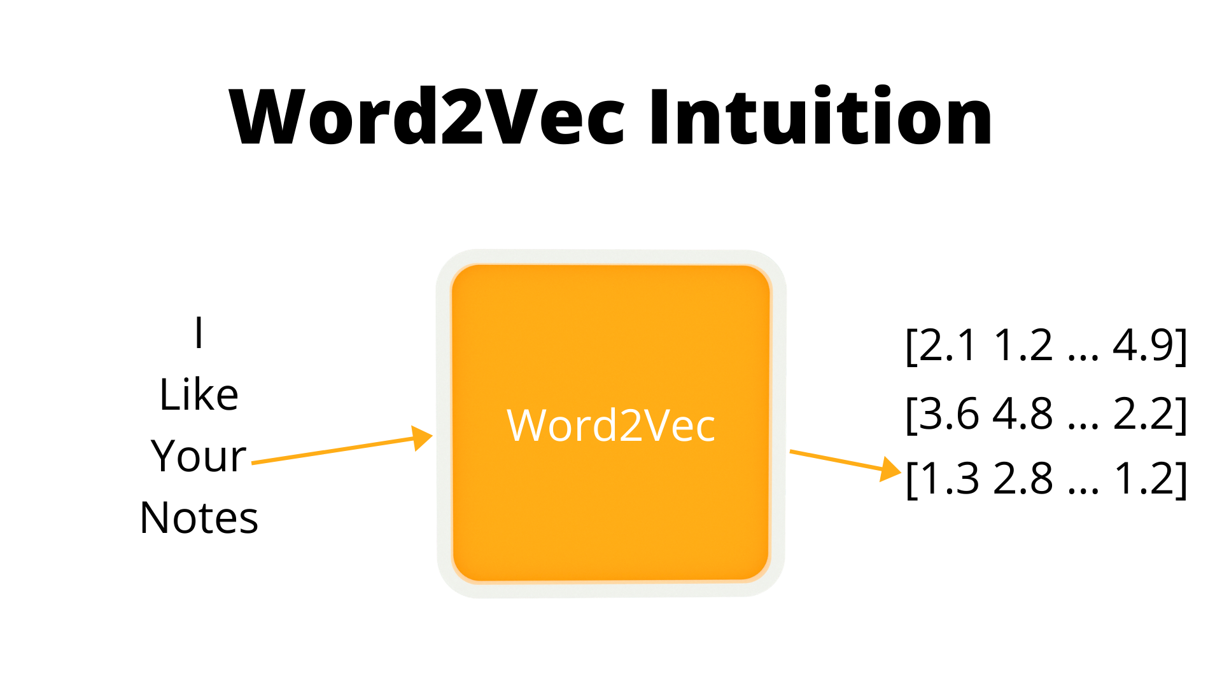

Slide 59
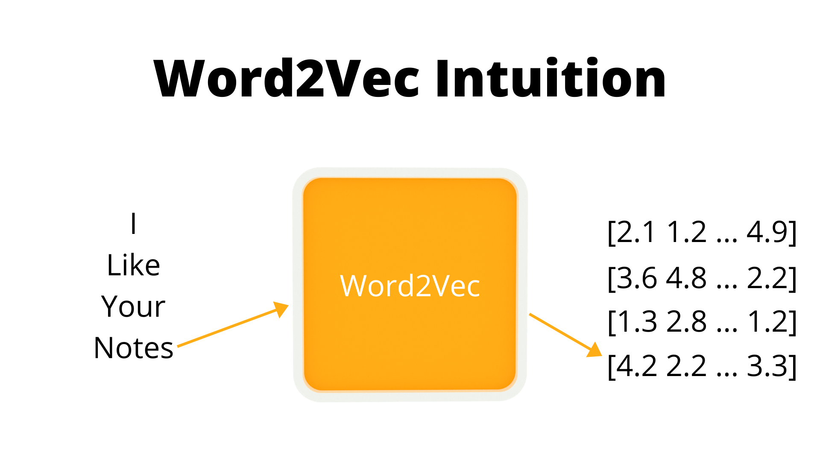

Slide 60
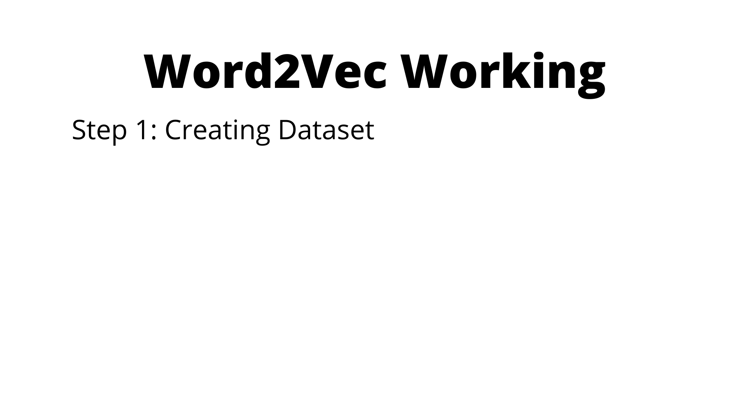

Slide 61


Slide 62
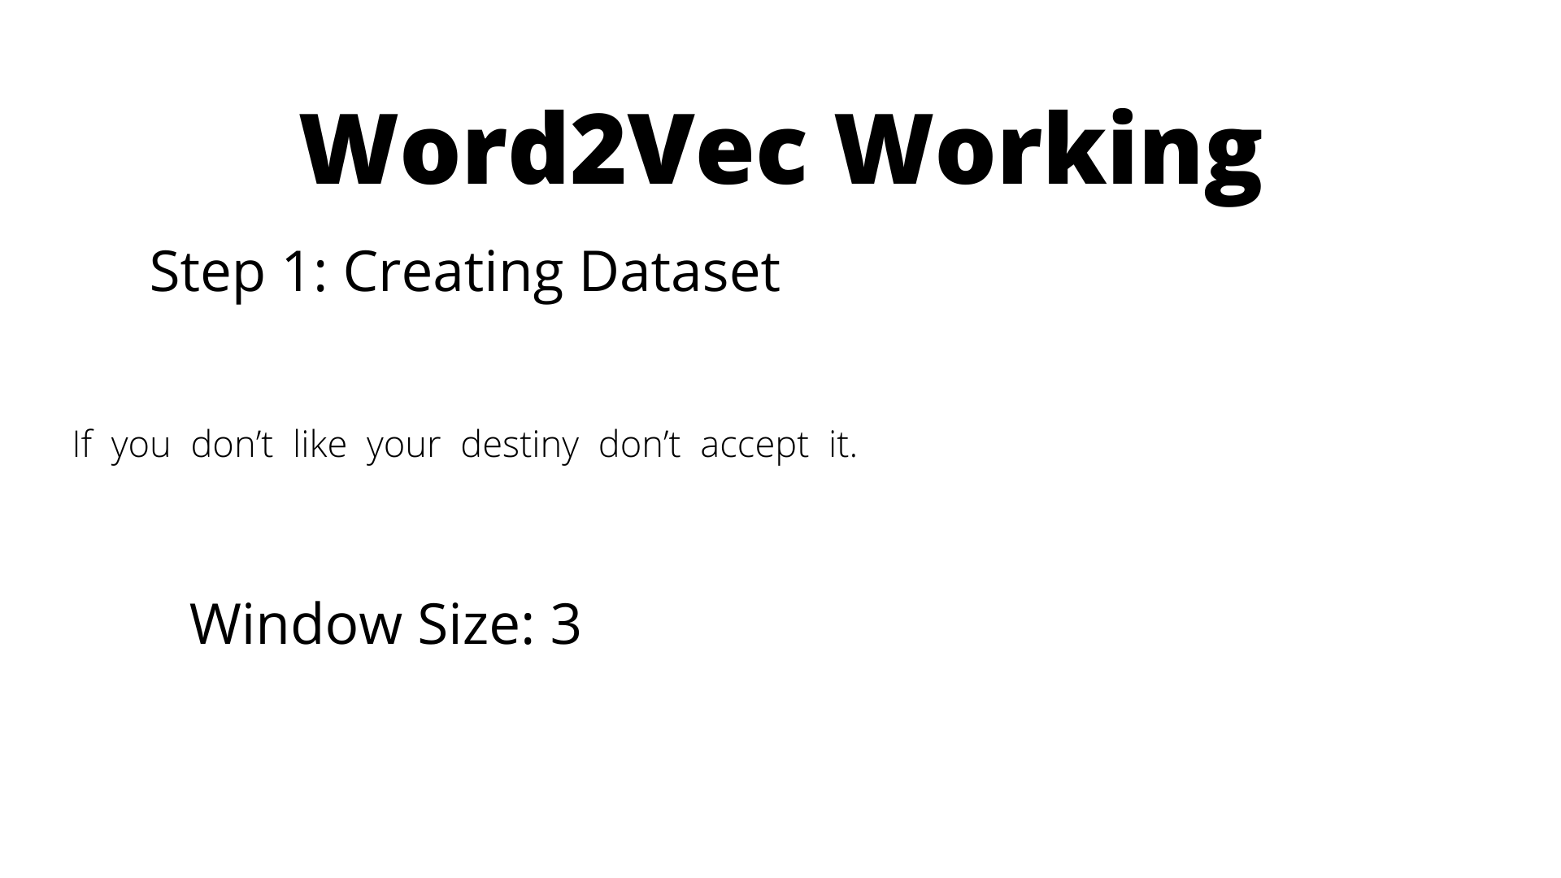

Slide 63
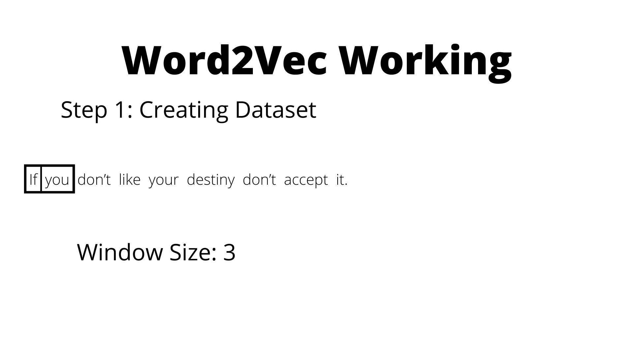

Slide 64
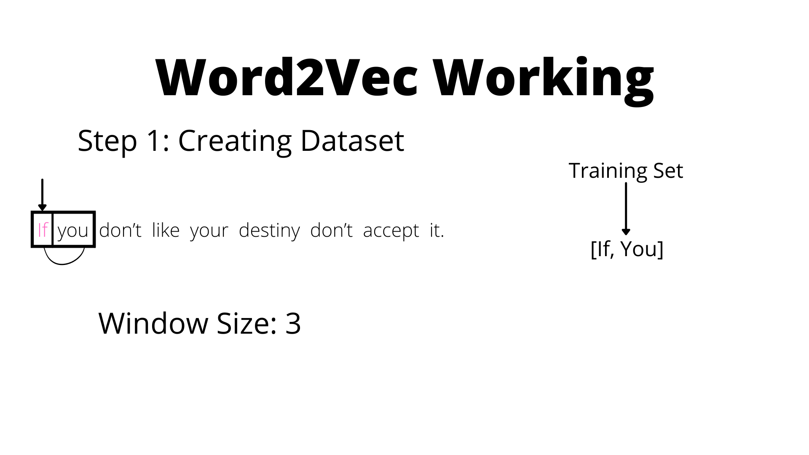

Slide 65
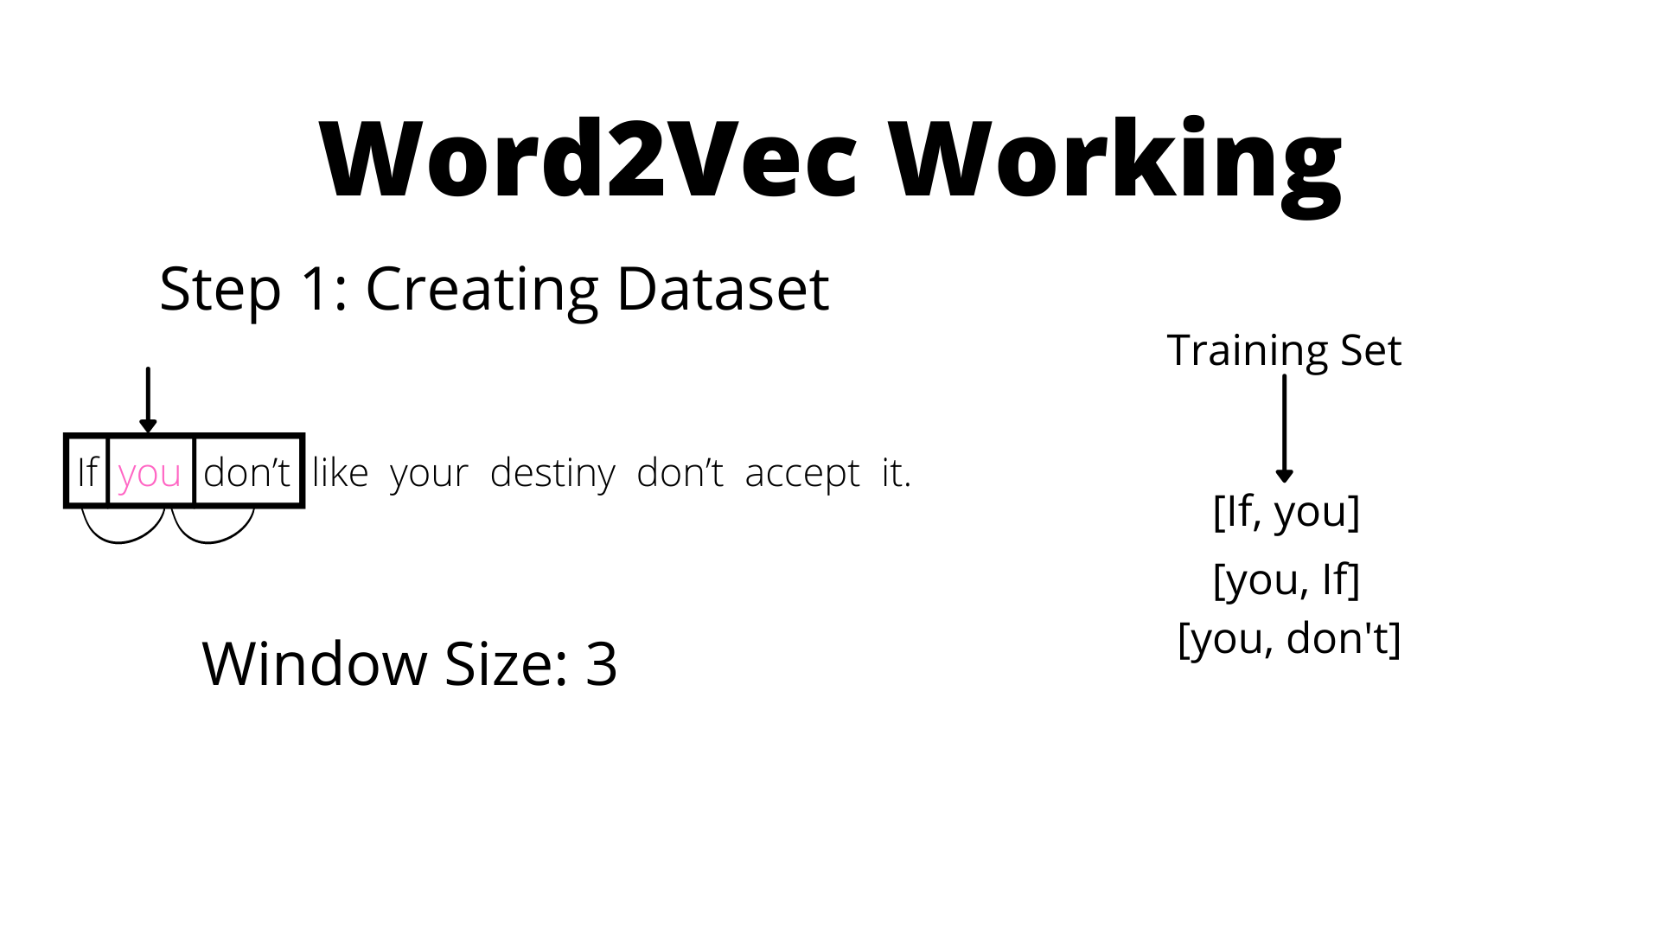

Slide 66
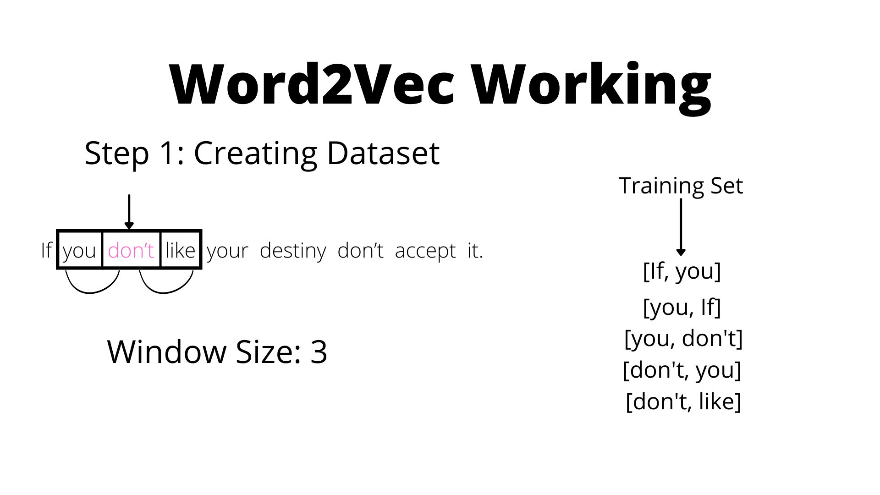

Slide 67
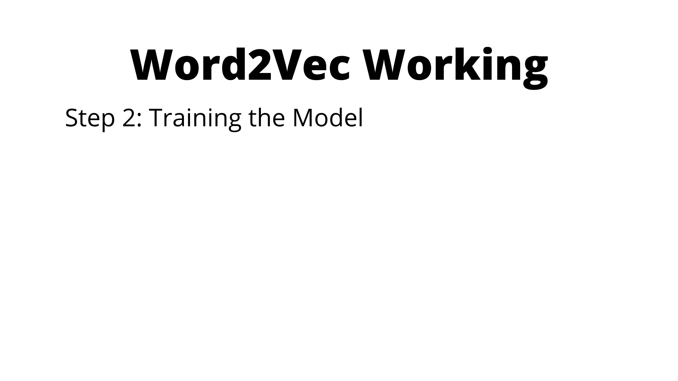

Slide 68
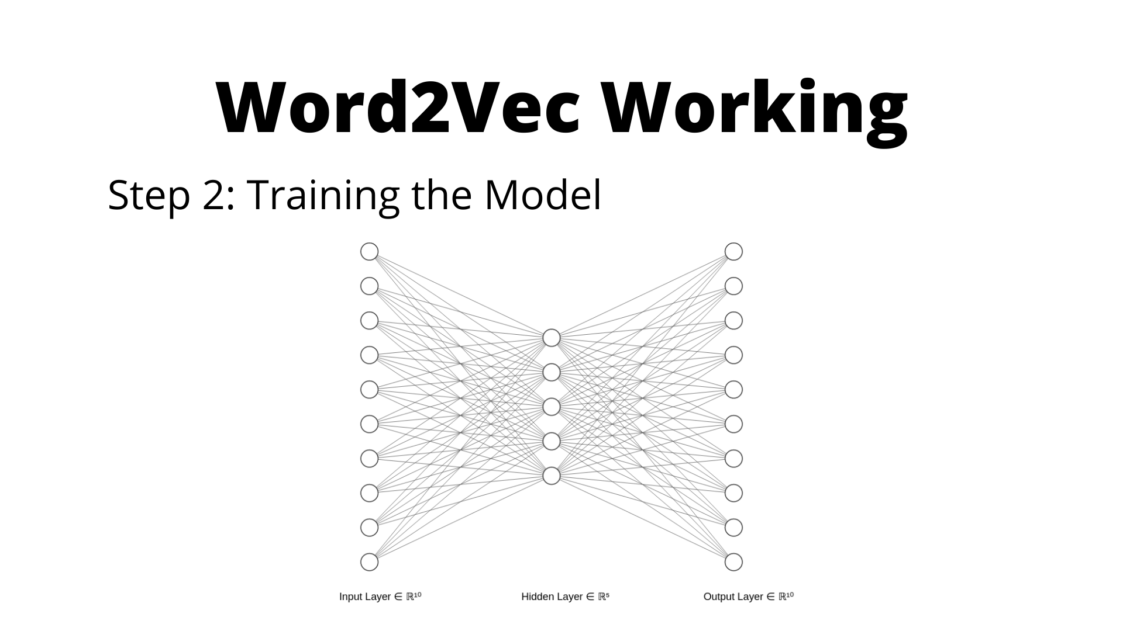

Slide 69
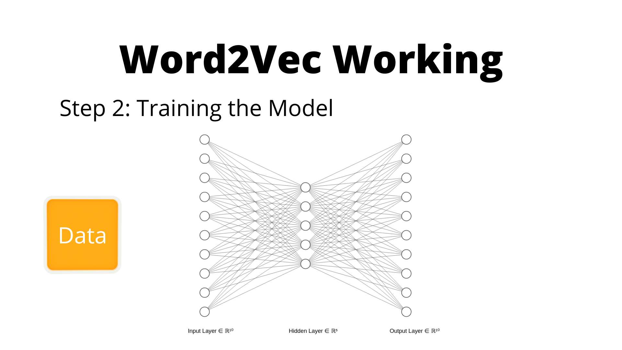

Slide 70
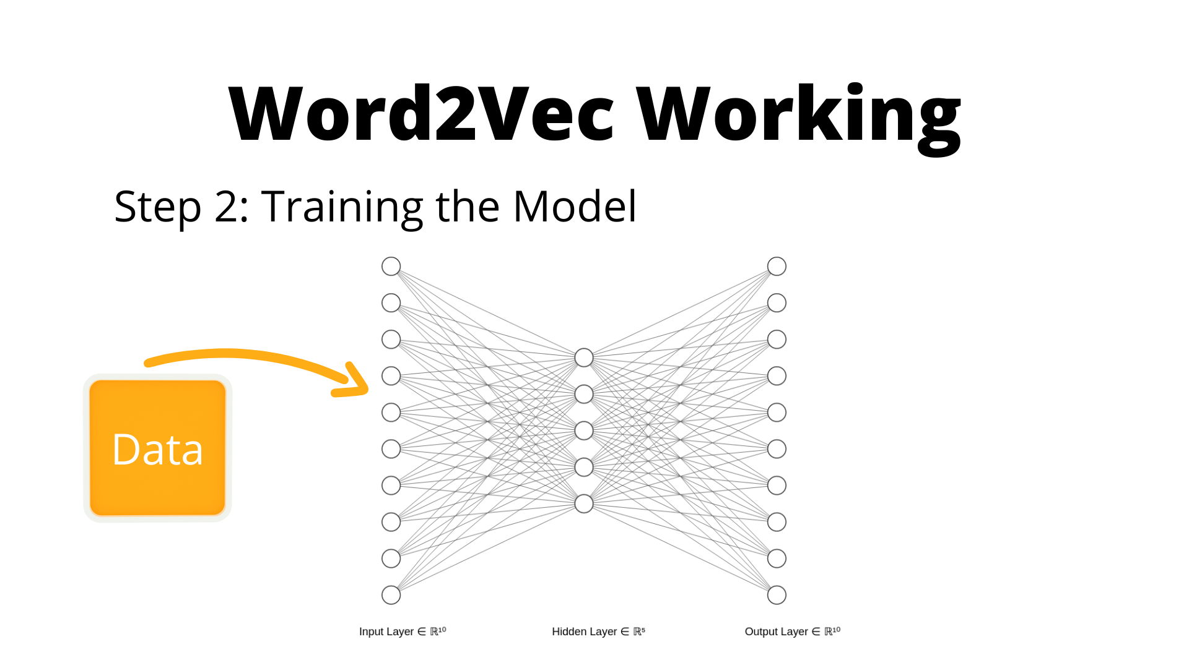

Slide 71
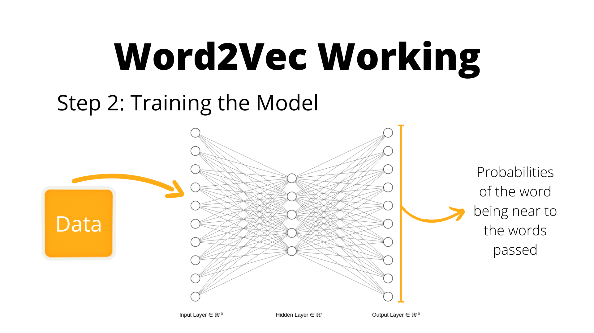

Slide 72


Slide 73


Slide 74


Slide 75


Slide 76


Slide 77
Sentences as Sequence

Slide 78

Sentences as Sequence
Sentences and Sequence
Following of one thing after another.
Sentences are essentially sequences where one word follows another.
Sentence as sequence of vectors
So What?
If Sentences can be represented as sequence of vectors, then we can use RNN models to improve our results.
Ordering matters in sentences hence RNN models might capture context better than ML models.

Slide 79
Using RNN Models for T.C.
A Visual Guide

Slide 80


Slide 81


Slide 82


Slide 83


Slide 84


Slide 85


Slide 86


Slide 87


Slide 88


Slide 89


Slide 90


Slide 91


Slide 92


Slide 93


Slide 94


Slide 95


Slide 96


Slide 97


Slide 98


Slide 99


Slide 100


Slide 101
What’s Next?

Slide 102



Where to go from here?
Elmo for Context Dependant Embeddings
Attention and Transformers
SOTA Models for Text Classification
Elmo can be used to get embeddings that are dependant on the context.
What is Attention? What are Transformers? What problems they address?
Using pretrained models like Bert, Roberta, XLNet etc. for classification.

Slide 103
Thanks!
Any Questions?

